Slide 1


AI in Integrative Health
Unlocking Potential and Navigating Pitfalls for Future Innovation
Melinda Ring, MD
Darshan Mehta, MD MPH
Notes:
Darshan

Slide 2



Learning Objectives
Understand the diverse applications of AI in integrative health, focusing on clinical care, health professional education, and patient education
Identify AI’s ethical challenges and risks, including concerns over privacy, bias, and the balance between technology and human-centered care
Explore strategies for the responsible integration of AI in IH while preserving the core principles of relationship-based, holistic care
Notes:
Darshan

Slide 3

Use Case I:
Clinical Applications

Slide 4
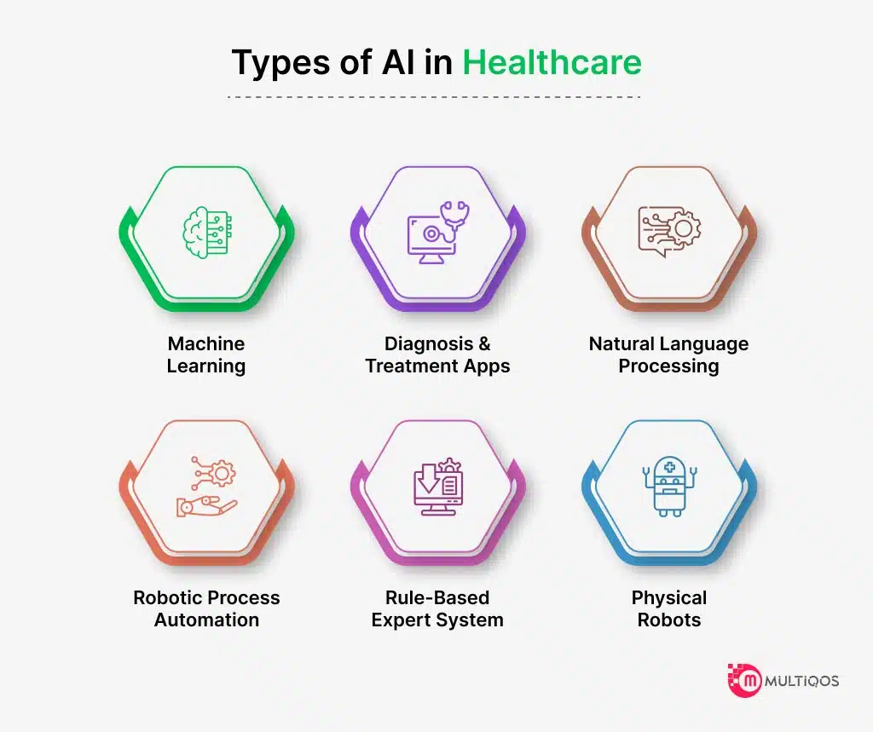
Uses of Artificial Intelligence in Clinical Medicine
Machine Learning in Clinical Decision Support
  Deep Learning for Medical Imaging
Natural Language Processing
  Clinical Documentation
  Evidence Synthesis
Robotics and Physical AI Applications
Expert Systems and Fuzzy Logic
  Clinical reasoning by applying predefined guidelines to patient data
Reinforcement Learning for Personalized Medicine
  Personalized medicine and response to chemotherapy
Notes:
Darshan

Slide 5
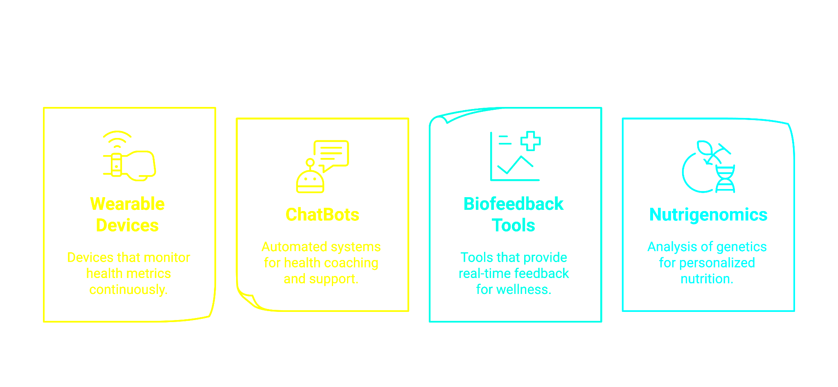

Slide 6
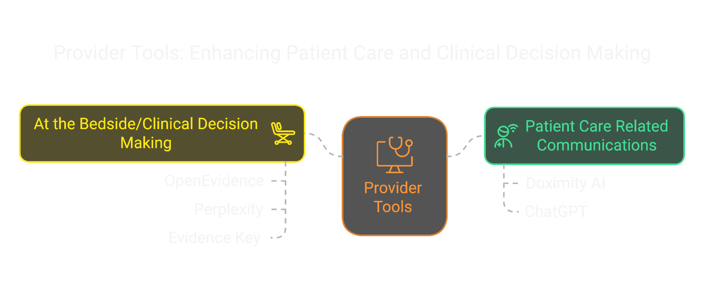

Slide 7
Provider tools
Patient care related communications
  Doximity AI (secure, free), ChatGPT, et al
At the bedside/clinical decision making
  OpenEvidence, Perplexity, Evidence Key, more on the horizon

Slide 8
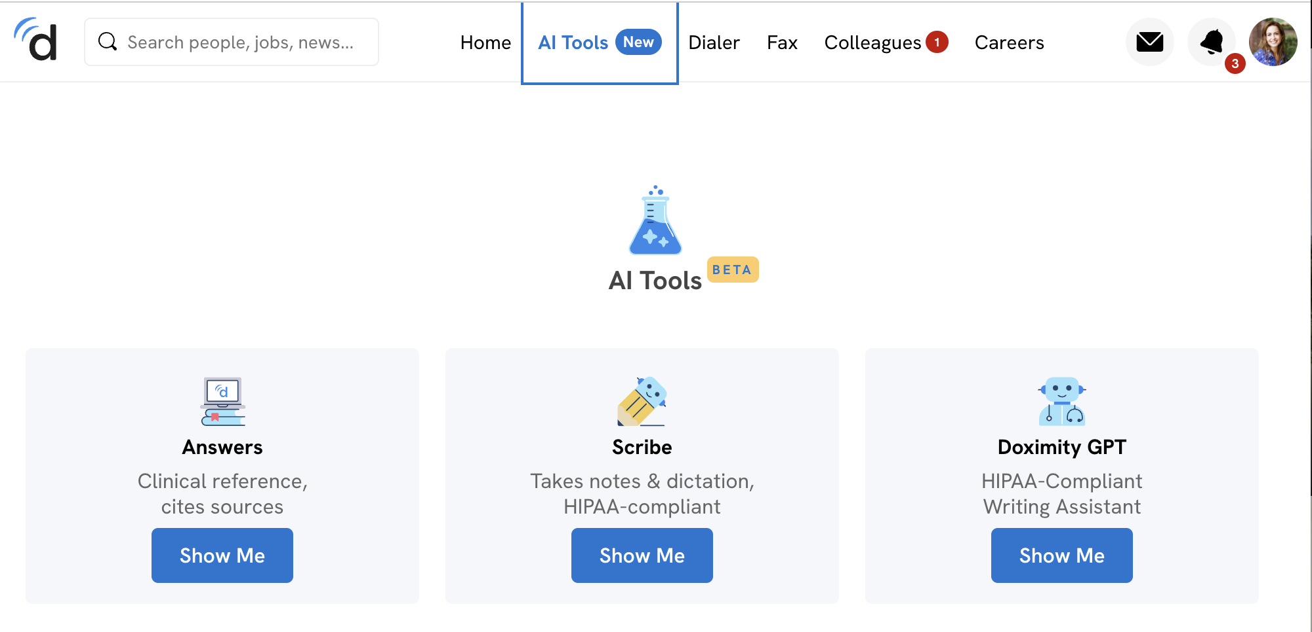
Notes:
Darshan

Slide 9
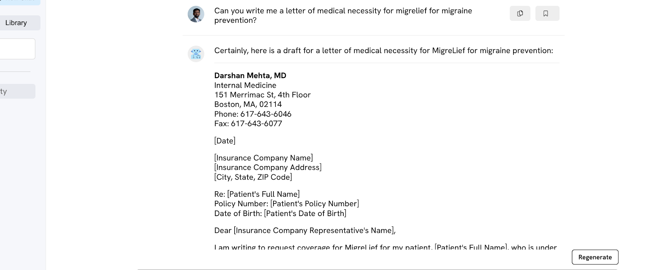
Letter of Medical Necessity – Doximity
Notes:
Darshan

Slide 10
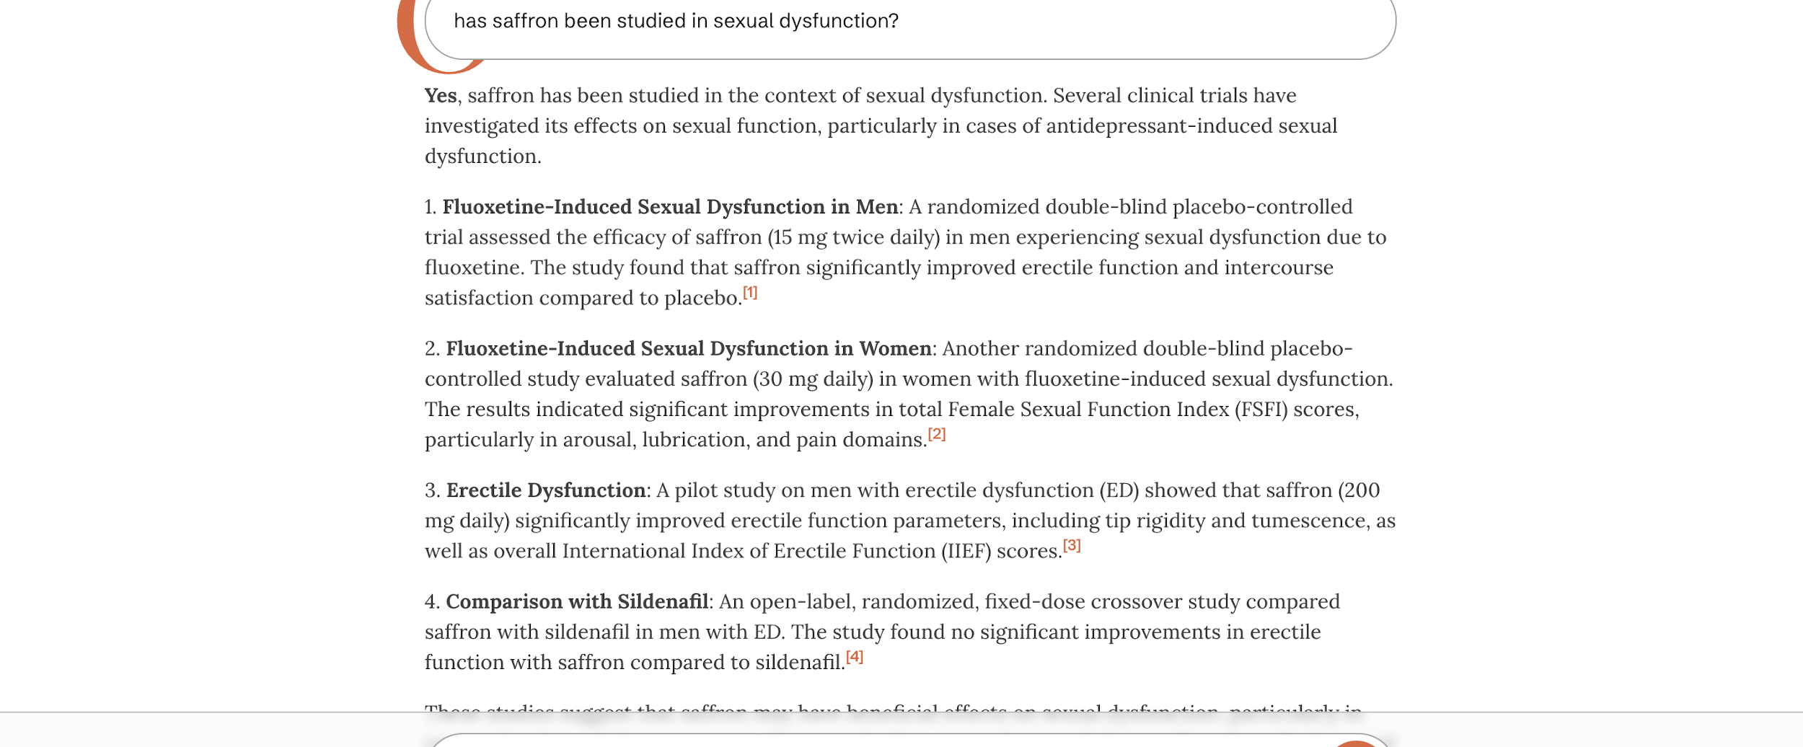
Synthesizing Evidence -- OpenEvidence
Notes:
Darshan

Slide 11
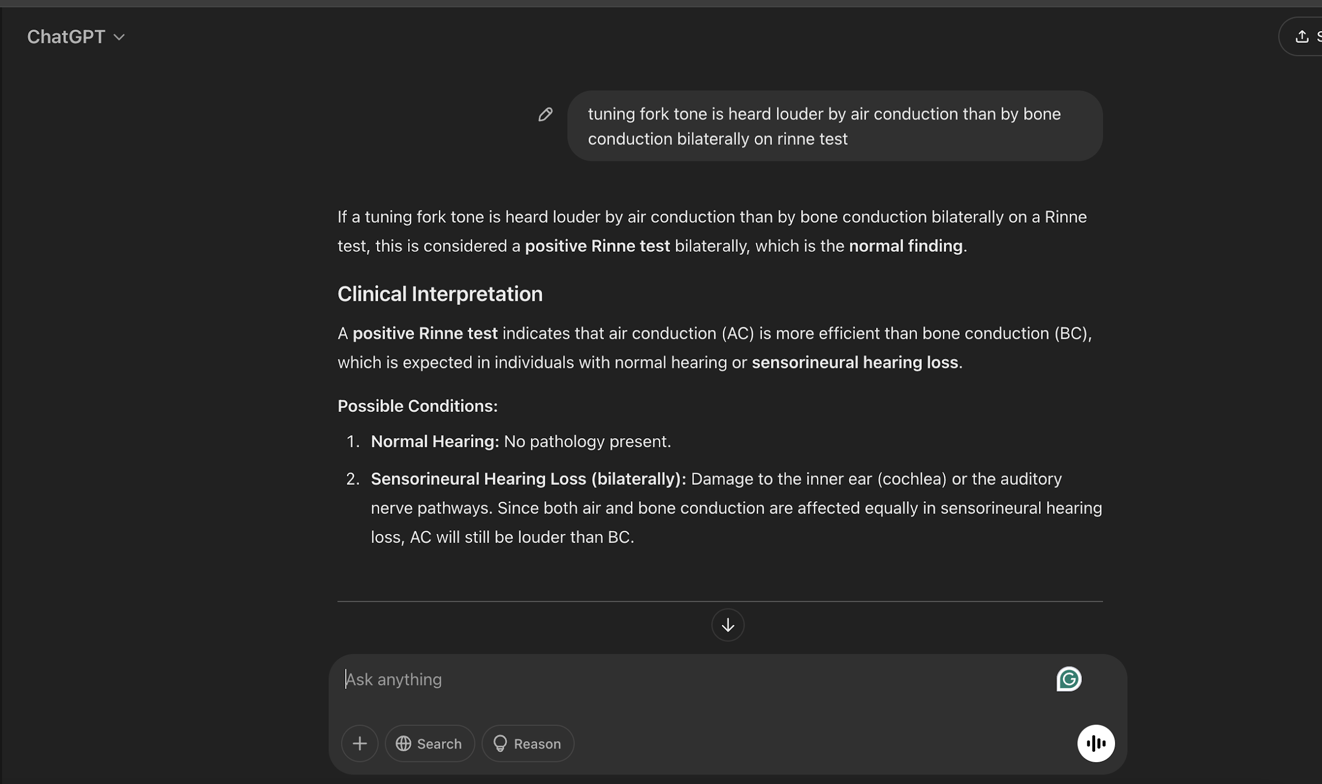
At the Bedside – ChatGPT
Notes:
Darshan

Slide 12
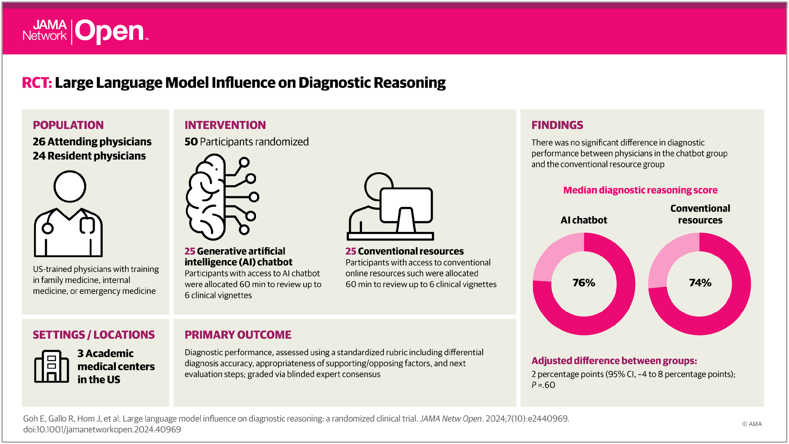
Notes:
Darshan

Slide 13
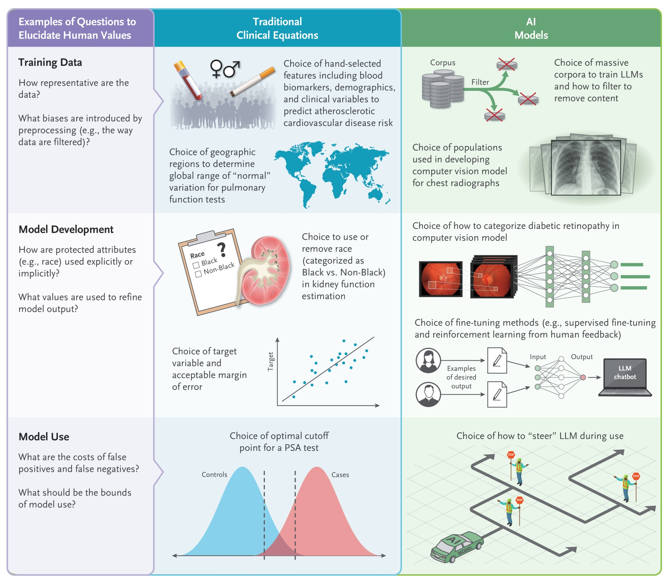

Entry Points and Choices for Human Values in Traditional Clinical Equations and New Artificial Intelligence Models.
Yu K-H et al. N Engl J Med2024;390:1895-1904
Notes:
Darshan
Figure 2 Entry Points and Choices for Human Values in Traditional Clinical Equations and New Artificial Intelligence Models. In both traditional clinical equations (e.g., the estimated glomerular filtration rate [eGFR]) and new artificial intelligence models (e.g., LLMs), human values enter at every stage, including in choices about training data, model development, and model use. Although the examples are highly varied, often the same questions (left column) can be used to elucidate human values in both traditional clinical equations (center column) and newer AI models (right column). PSA denotes prostate-specific antigen.

Slide 14
Let’s Practice!
Open an AI Tool
Use Doximity, OpenEvidence, or ChatGPT on your device.
Ask a Clinical Question
Enter a question relevant to your practice.
Review the Response
Is it accurate, useful, or biased?
Discuss with Your Table
Share key takeaways.
How could AI help—or mislead—in clinical care?
Notes:
Darshan

Slide 15

Use Case II:
Academics
Health professional education
Scholarly work

Slide 16
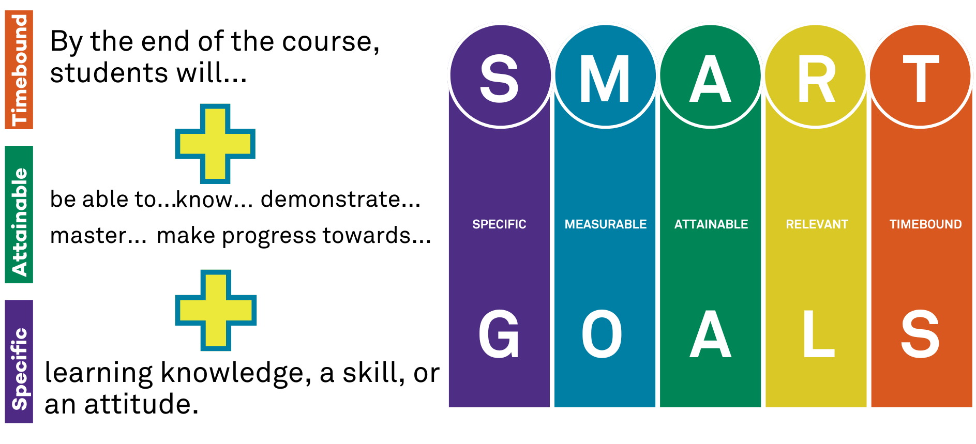
Part 1: Health Professional Education
From learning objectives to assessment

Slide 17
Example: Learning Outcomes
Starting Prompt
You are a higher educational course design expert who specializes in integrative medicine. Please recommend 10 course learning outcomes for a 2 week introductory course for fourth year medical students with 15 students taught a practical and broad overview of the field as an elective class. The course is Introduction to integrative medicine. [Here is the course description:].
This elective is an immersion into the field of integrative medicine. Over 30 percent of Americans use integrative medicine therapies according to the last NIH survey in 2017, with trends showing increases since then. Now more than ever it is imperative to be aware of evidence of integrative medicine therapies and how to counsel patients concerning their use. In addition, integrative medicine education provides important anti-burnout resources that physicians and physicians-in-training can use for their own well-being. Integrative medicine emphasizes the incorporation of all appropriate conventional and complementary approaches in an evidence-based way to optimize health, promote whole-person wellness and prevent chronic disease. The two-week-long rotation consists of ambulatory patient care and experiential learning at the Feinberg-affiliated Osher Center for Integrative Health at Northwestern. Participants learn about evidence behind dietary supplements, herbs and integrative modalities, to how to use mindfulness, yoga, culinary medicine and exercise for both patients and themselves. There are experiential opportunities for acupuncture, massage and chiropractic treatments.
You are a higher educational course design expert who specializes in [e.g., inclusive teaching or discipline]. Please recommend 10 course learning outcomes for a [duration] [level] course for [audience] with [X number] students taught [modality] as a [placement in curriculum] class. The course is [on topic or called title]. [Here is the course description:].

Slide 18
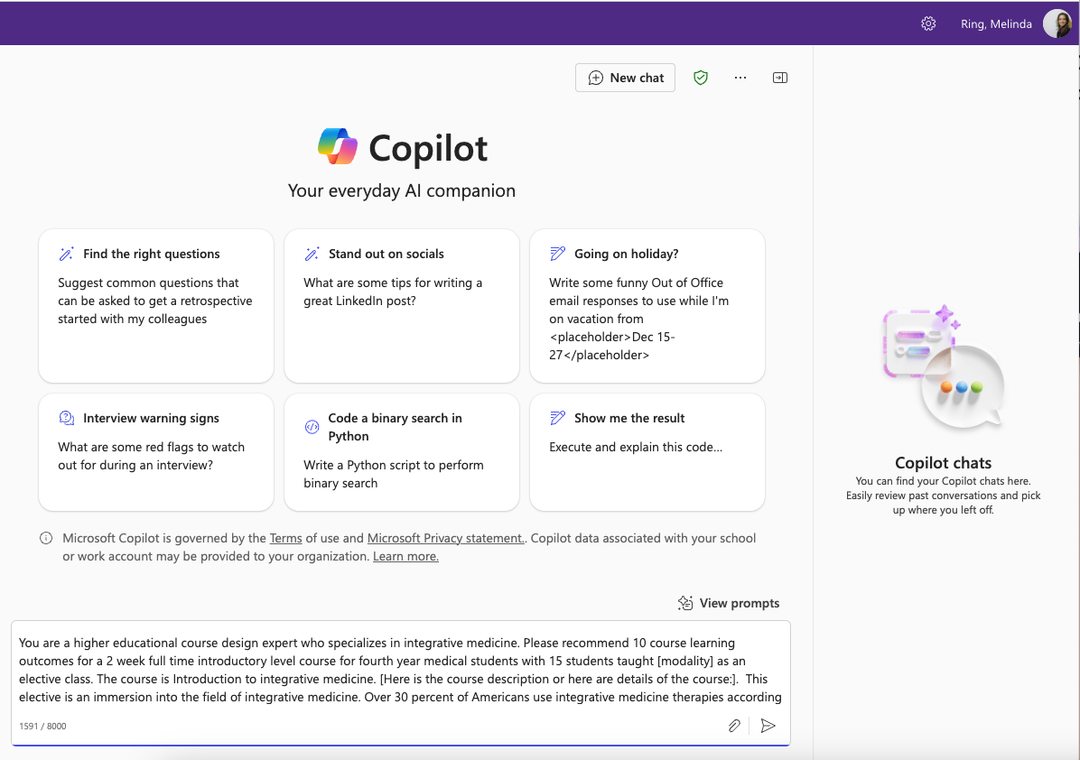
Enter into the AI app prompt box
Shown here: Copilot, Office 365 integrated option)
Notes:
Microsoft 365 AI

Slide 19
That sounds like a fantastic course! Here are 10 recommended learning outcomes for your "Introduction to Integrative Medicine" course:
Understand the Principles of Integrative Medicine: Students will be able to articulate the core principles and philosophy of integrative medicine, including its emphasis on whole-person wellness and the integration of conventional and complementary approaches.
Evaluate Evidence-Based Integrative Therapies: Students will critically assess the scientific evidence supporting various integrative medicine therapies, including dietary supplements, herbs, acupuncture, massage, and chiropractic treatments.
Counsel Patients on Integrative Therapies: Students will demonstrate the ability to effectively counsel patients on the use of integrative therapies, considering both the benefits and potential risks.
Apply Mindfulness and Stress Reduction Techniques: Students will practice and teach mindfulness and other stress reduction techniques, understanding their role in both patient care and personal well-being.
Incorporate Yoga and Exercise into Patient Care: Students will learn how to integrate yoga and other forms of exercise into treatment plans to promote physical and mental health.
Utilize Culinary Medicine: Students will explore the principles of culinary medicine and how dietary choices can be used to prevent and manage chronic diseases.
Experience and Reflect on Integrative Modalities: Through experiential learning, students will participate in integrative therapies such as acupuncture, massage, and chiropractic treatments, and reflect on their potential benefits and applications.
Promote Physician Well-being: Students will identify and utilize integrative medicine strategies to enhance their own well-being and prevent burnout.
Develop Patient-Centered Care Plans: Students will create comprehensive, patient-centered care plans that incorporate both conventional and integrative therapies.
Engage in Interdisciplinary Collaboration: Students will collaborate with practitioners from various disciplines to provide holistic and coordinated care, understanding the roles and contributions of different healthcare providers in integrative medicine.
These outcomes should provide a robust framework for your course, ensuring that students gain both theoretical knowledge and practical skills in integrative medicine. How do these align with your vision for the course?
Understand the Principles of Integrative Medicine: Students will be able to articulate the core principles and philosophy of integrative medicine, including its emphasis on whole-person wellness and the integration of conventional and complementary approaches.

Slide 20
From Learning Objectives to >> Authentic Assessments
Starting prompt
For the same course and based on my chosen learning outcomes, what authentic assessments would you recommend I assign students? Provide 10 possible authentic assessments.

Slide 21
Here are 10 authentic assessments that align with the learning outcomes for your "Introduction to Integrative Medicine" course:
1. Patient Case Study Analysis
Description: Students analyze a detailed patient case study, identifying integrative therapies that could be beneficial, and justify their choices based on evidence.
Learning Outcomes Addressed: Evaluate Evidence-Based Integrative Therapies, Develop Patient-Centered Care Plans.
2. Role-Playing Patient Counseling Sessions
Description: Students participate in role-playing exercises where they counsel a simulated patient on integrative therapies, followed by peer and instructor feedback.
Learning Outcomes Addressed: Counsel Patients on Integrative Therapies, Communication Skills.
3. Mindfulness Practice and Reflection
Description: Students engage in daily mindfulness practices and maintain a reflection journal documenting their experiences and insights.
Learning Outcomes Addressed: Apply Mindfulness and Stress Reduction Techniques, Promote Physician Well-being.
4. Yoga and Exercise Plan Development
Description: Students create a personalized yoga and exercise plan for a hypothetical patient, considering the patient’s specific health conditions and goals.
Learning Outcomes Addressed: Incorporate Yoga and Exercise into Patient Care, Develop Patient-Centered Care Plans.
5. Culinary Medicine Project
Description: Students design a week-long meal plan for a patient with a chronic condition, incorporating principles of culinary medicine and providing recipes.
Learning Outcomes Addressed: Utilize Culinary Medicine, Evaluate Evidence-Based Integrative Therapies.
3. Mindfulness Practice and Reflection
Description: Students engage in daily mindfulness practices and maintain a reflection journal documenting their experiences and insights.
Learning Outcomes Addressed: Apply Mindfulness and Stress Reduction Techniques, Promote Physician Well-being.

Slide 22
6. Experiential Learning Reflection
Description: After participating in integrative therapies such as acupuncture or massage, students write a reflective essay on their experiences and potential applications in clinical practice.
Learning Outcomes Addressed: Experience and Reflect on Integrative Modalities, Promote Physician Well-being.
7. Interdisciplinary Collaboration Simulation
Description: Students work in groups to simulate an interdisciplinary team meeting, developing a comprehensive care plan for a complex patient case.
Learning Outcomes Addressed: Engage in Interdisciplinary Collaboration, Develop Patient-Centered Care Plans.
8. Personal Well-being Plan
Description: Students create a personal well-being plan that incorporates integrative medicine strategies to prevent burnout and promote self-care.
Learning Outcomes Addressed: Promote Physician Well-being, Apply Mindfulness and Stress Reduction Techniques.
9. Research Presentation
Description: Students select an integrative therapy, conduct a literature review, and present their findings on its efficacy and safety to the class.
Learning Outcomes Addressed: Evaluate Evidence-Based Integrative Therapies, Communication Skills.
10. Patient Education Materials
Description: Students develop educational materials (e.g., brochures, videos) to inform patients about specific integrative therapies, ensuring the content is evidence-based and accessible.
Learning Outcomes Addressed: Counsel Patients on Integrative Therapies, Communication Skills.
These assessments are designed to be practical and reflective of real-world applications, helping students to integrate their learning into clinical practice. How do these align with your vision for the course?

Slide 23
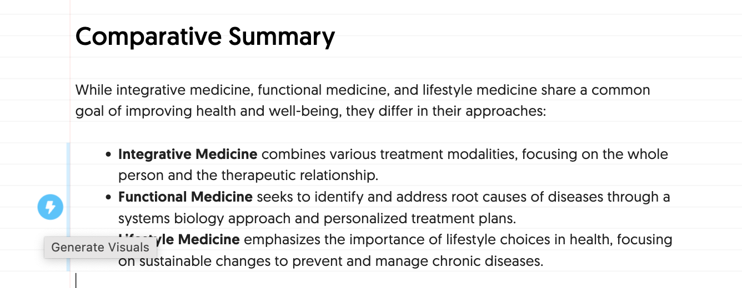
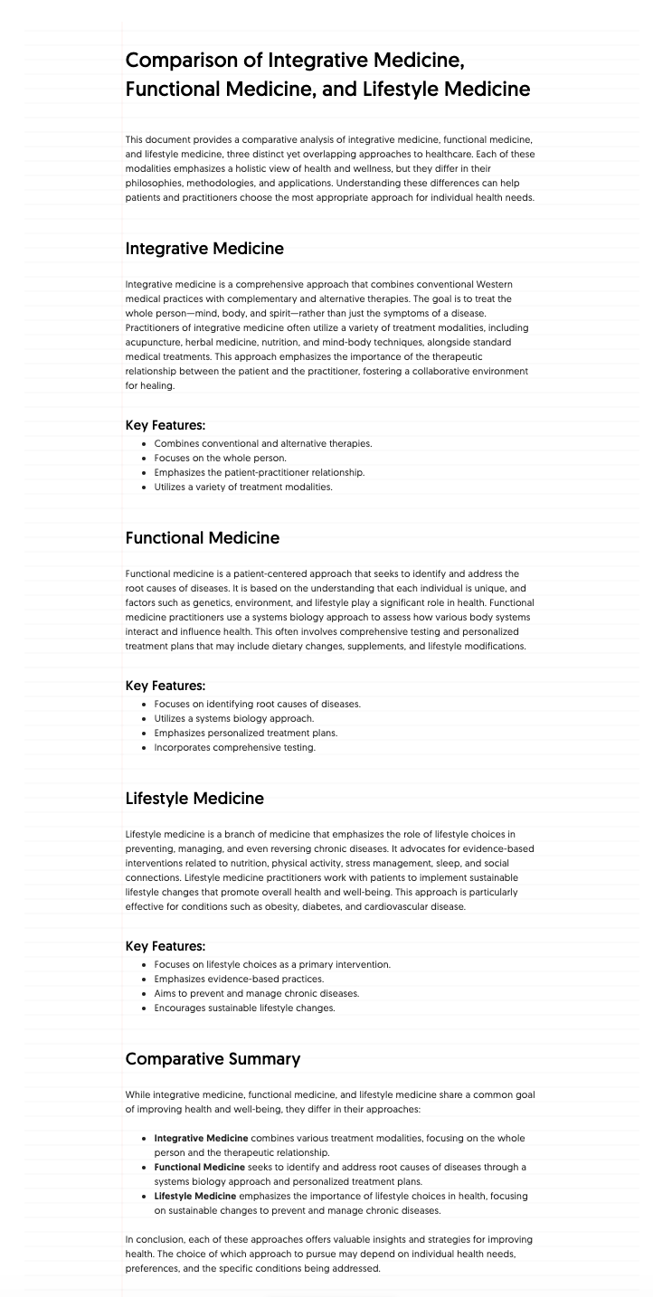
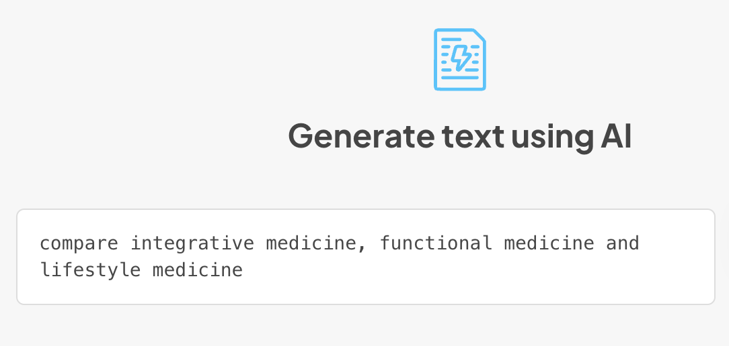
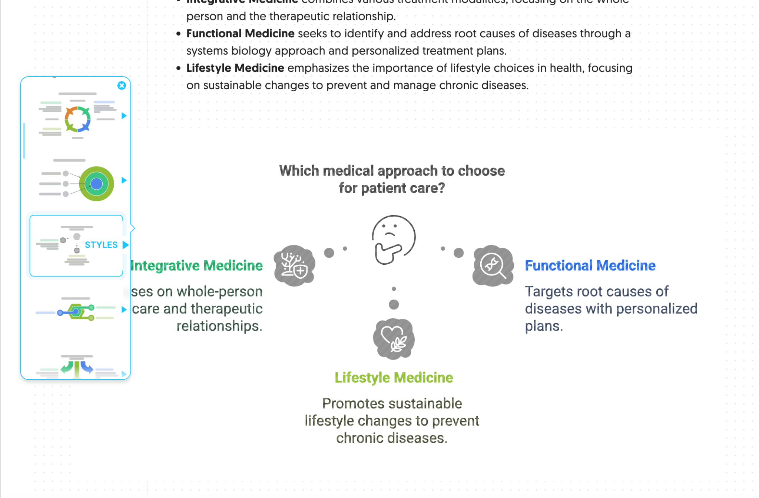
Creating engaging lectures/images
eg Napkin.ai
Notes:
To begin, you can either paste your existing text content or use our generative AI feature to create content from scratch.

Slide 24
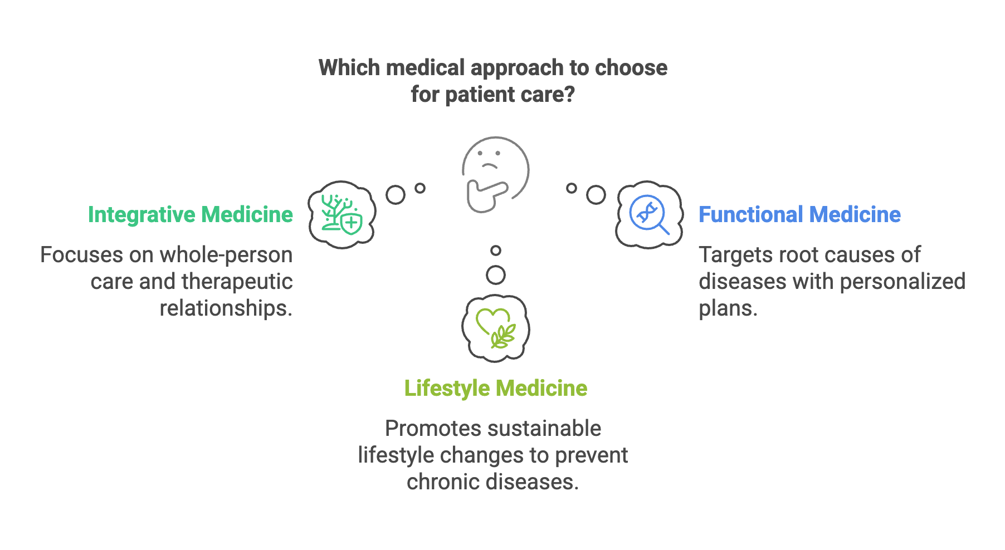
napkin.ai
Notes:
To begin, you can either paste your existing text content or use our generative AI feature to create content from scratch.

Slide 25

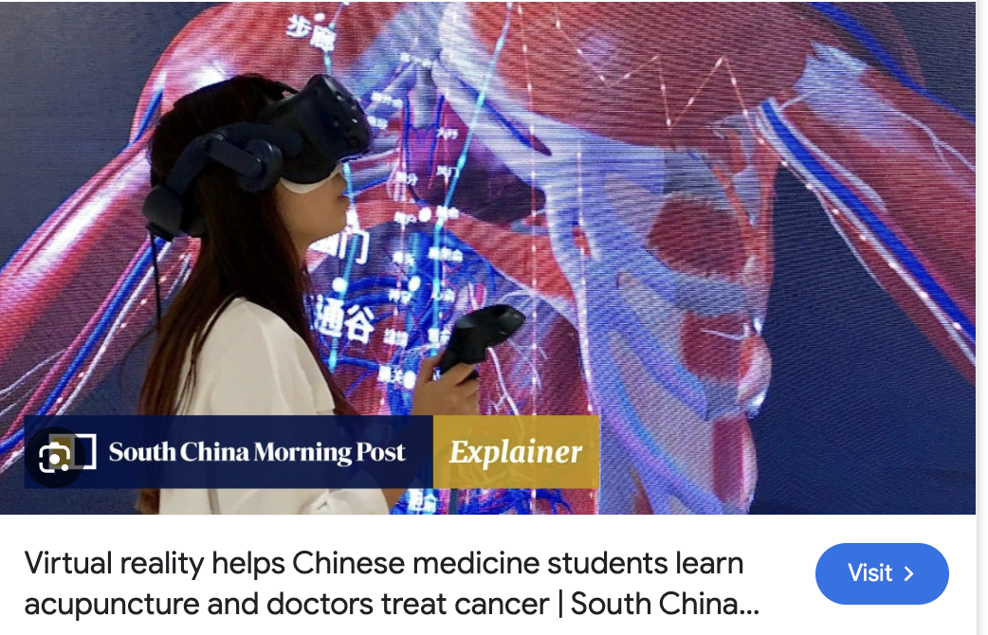
And so much more…
Exam questions
AI-powered patient scenarios
  OSCE-style training (conversational AI patients) Example: AI-generated patient cases for nutrition counseling
  Novel case scenarios or updating existing cases with new twists
Virtual/Augmented Reality & AI
  Example: VR integrative therapy simulations with AI-driven real-time feedback in virtual clinical cases

Slide 26
Part 2: AI for Scholarly Work
Examples: Literature Reviews, Article summaries
Search: eg Elicit, SciSpace, Consensus, DeepSearch (in ChatGPT et al)
Mapping: eg Litmaps, ResearchRabbit (free), ConnectedPapers
Reading papers/summarizing: ChatGPT, SciSpace (turns into podcast)
Multi-document chat: Notebook LM
Writing/editing: ChatGPT Canvas, can interact/chat with your document; Jenny AI (adds citations as go)
Data/analysis - Julius AI; DataLine

Slide 27
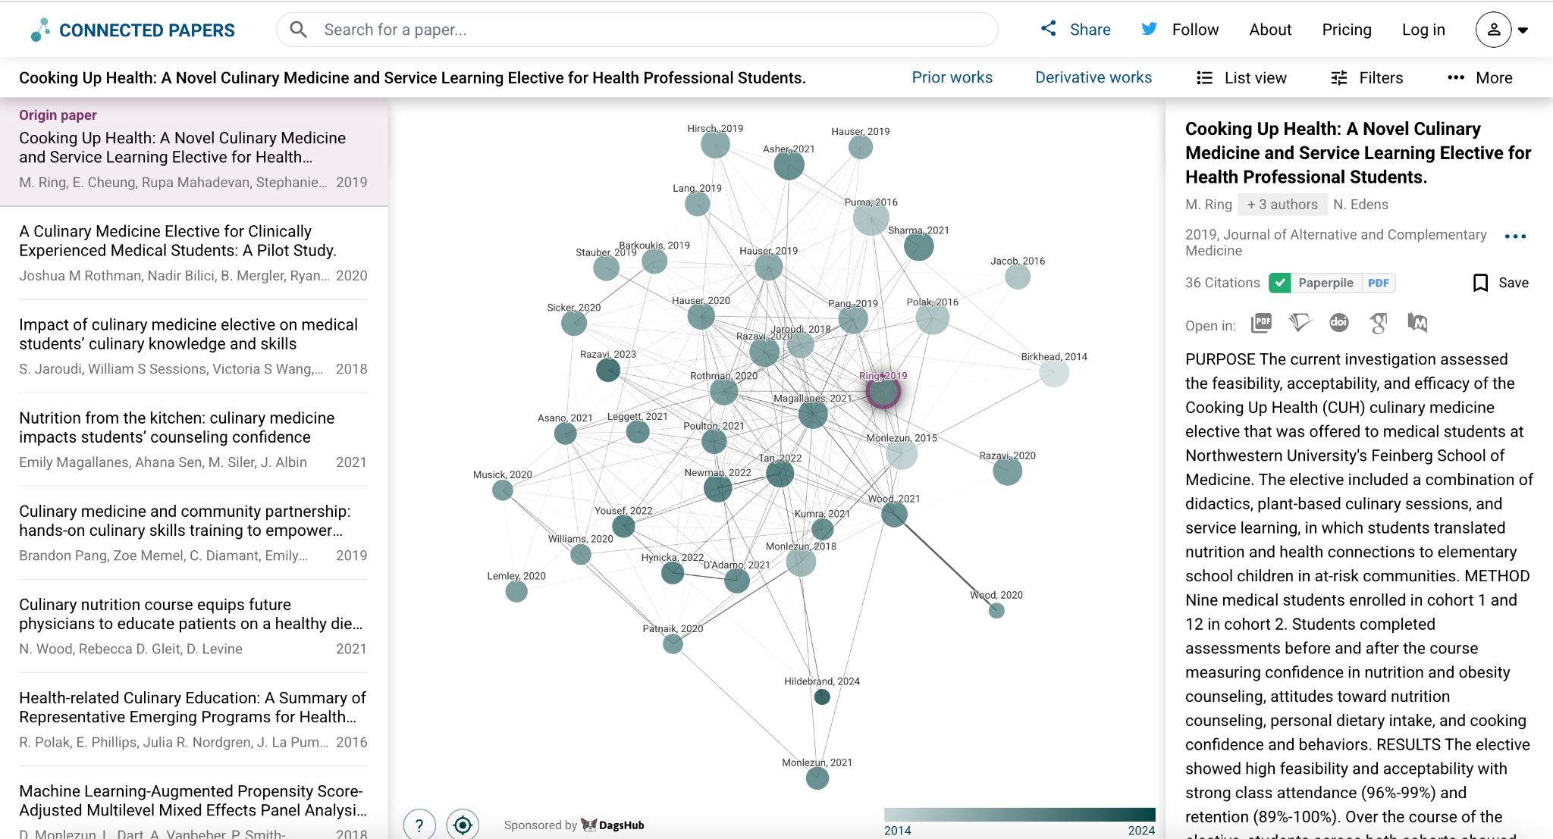

Slide 28
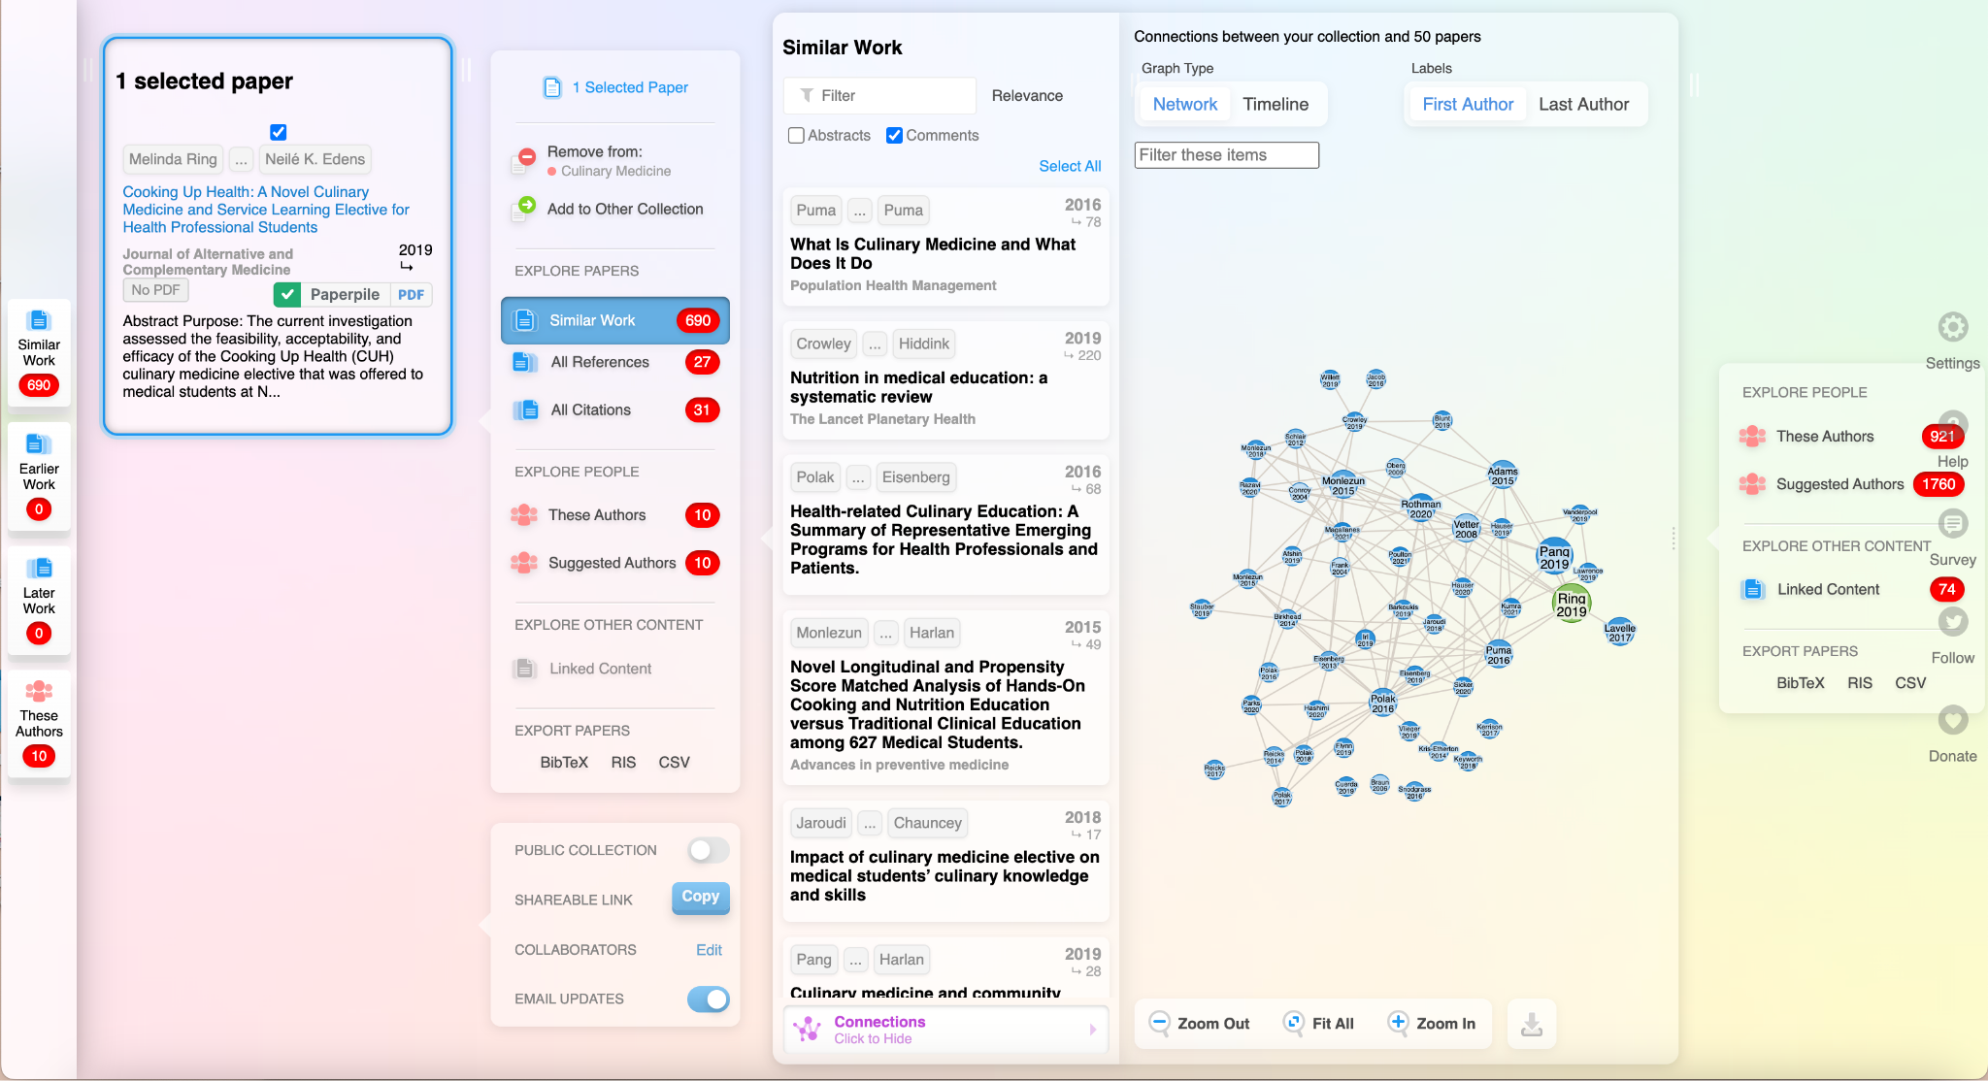

Slide 29
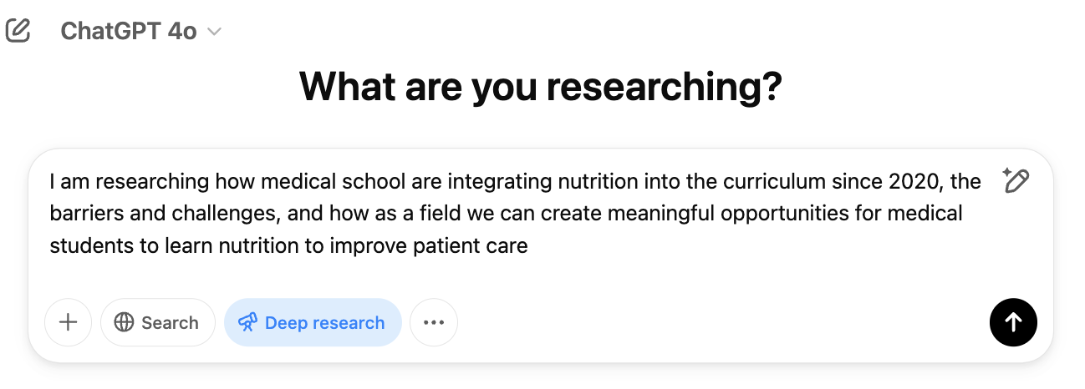
Deep seek searches

Slide 30
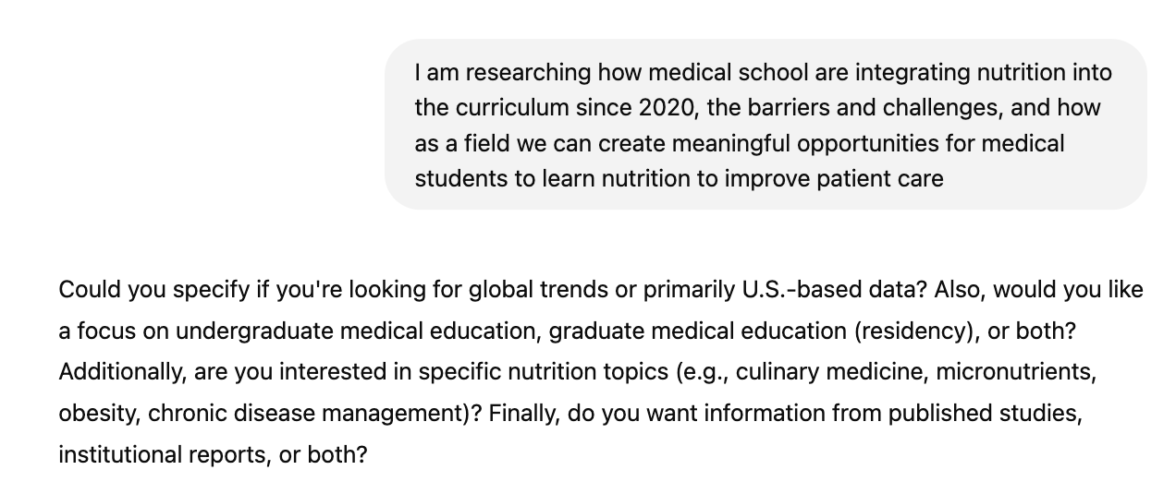

Slide 31
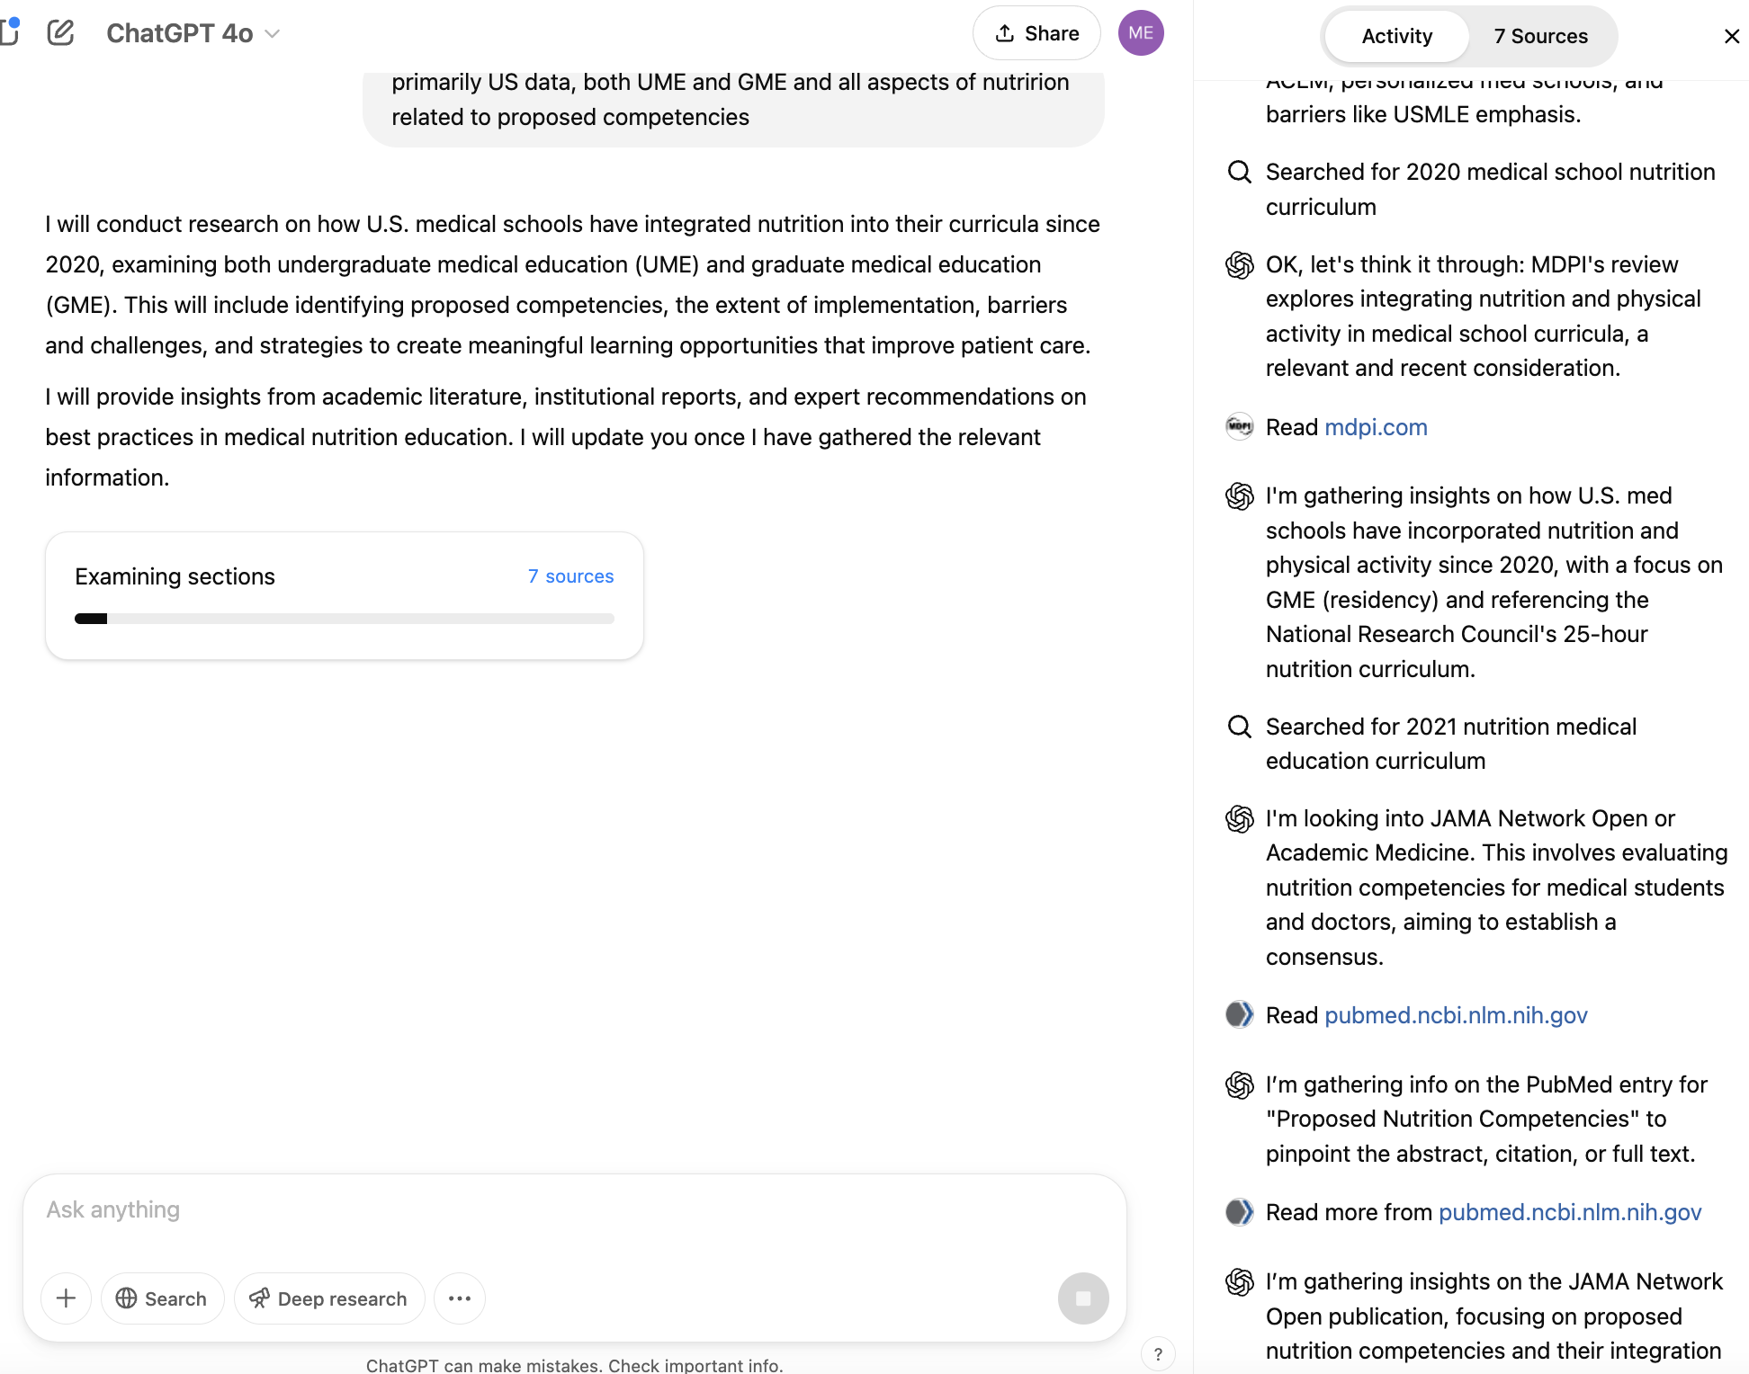
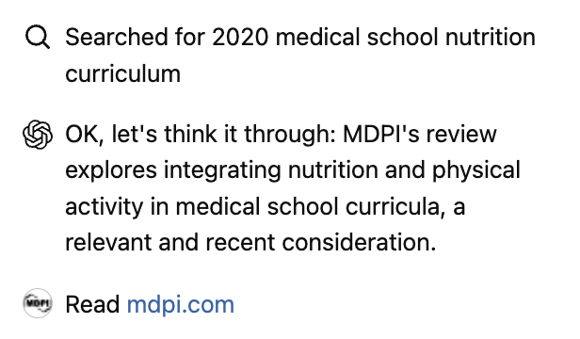
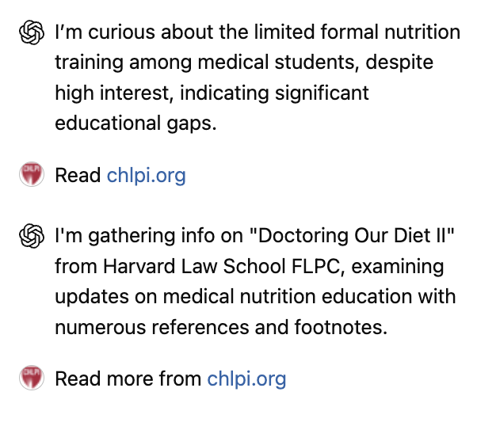

Slide 32
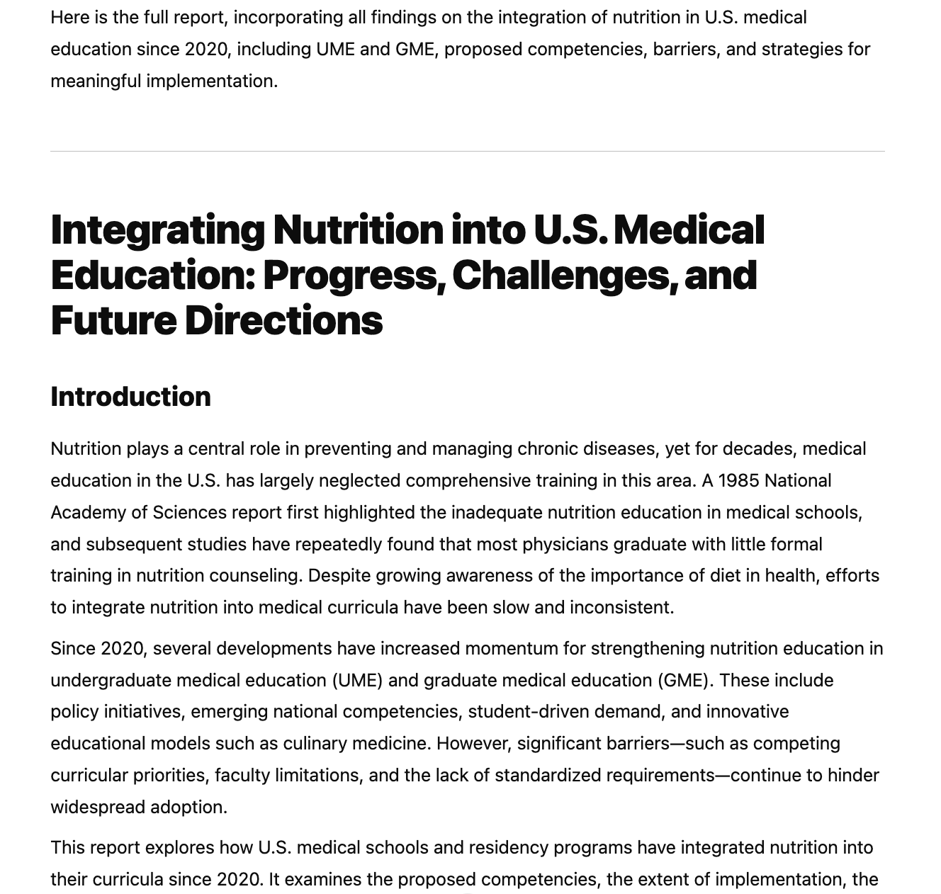
Research
completed in 7 minutes (!)
29 verified sources
1173 word report
Integrating Nutrition into U.S. Medical Education: Progress, Challenges, and Future Directions
OUTLINE
Introduction
Integration of Nutrition in Undergraduate Medical Education
  Current Status and Implementation
  Developments Since 2020
  Extent of Integration
Integration of Nutrition in Graduate Medical Education (GME)
Current Status of Nutrition in Residency Training
  Developments and Programs Since 2020
  Barriers and Challenges to Nutrition Education Integration
Strategies and Best Practices for Effective Nutrition Education
Conclusion

Slide 33
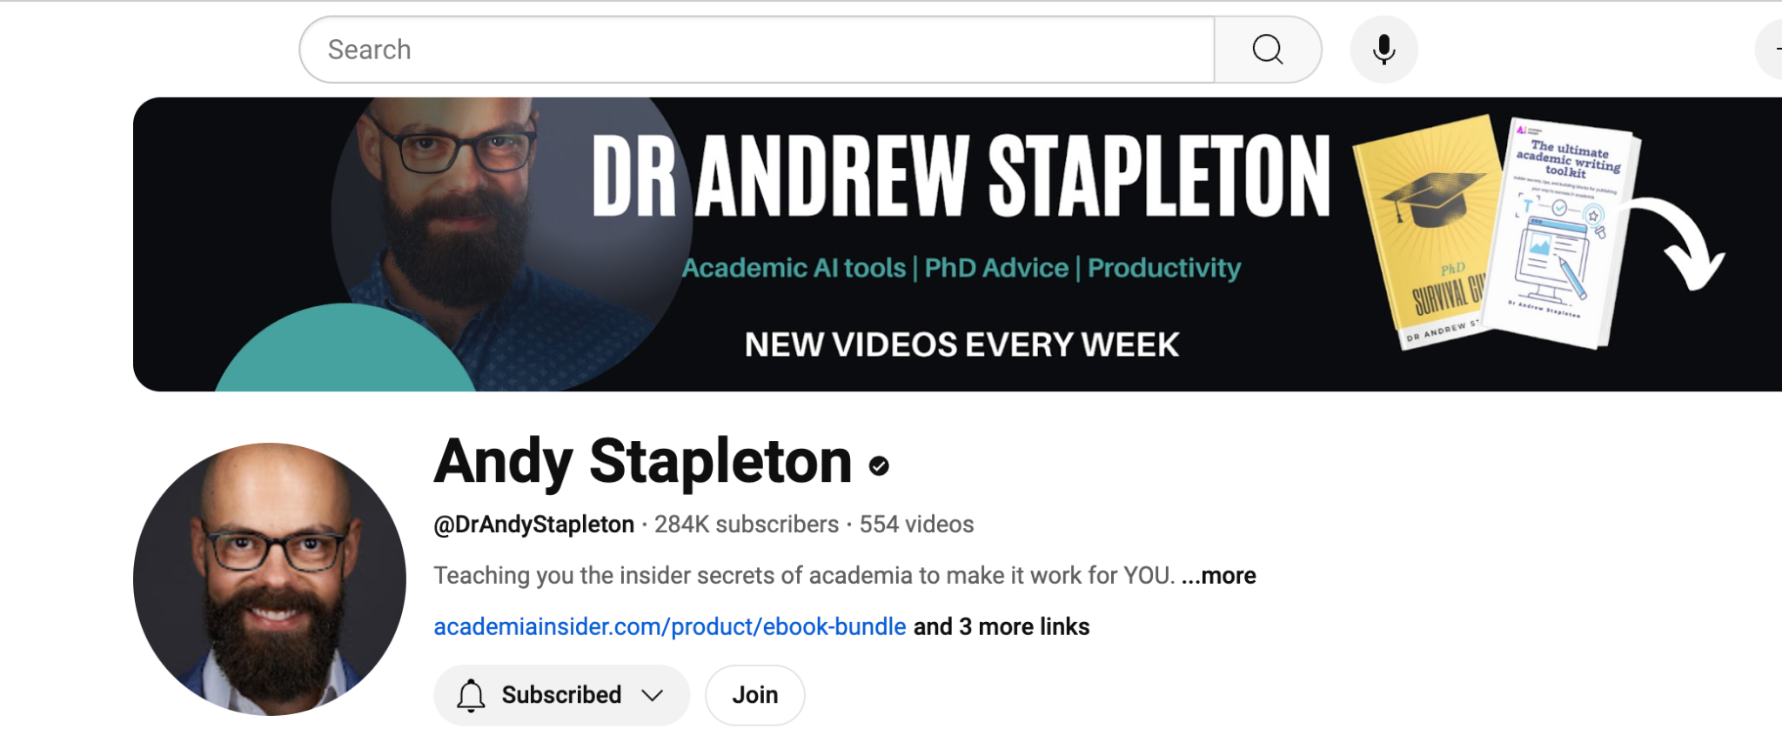
Great YouTuber for learning more about
AI Tools for Scholarly Work
Notes:
Melinda’s last slide

Slide 34

Use Case III:
Public Education

Slide 35
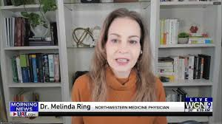
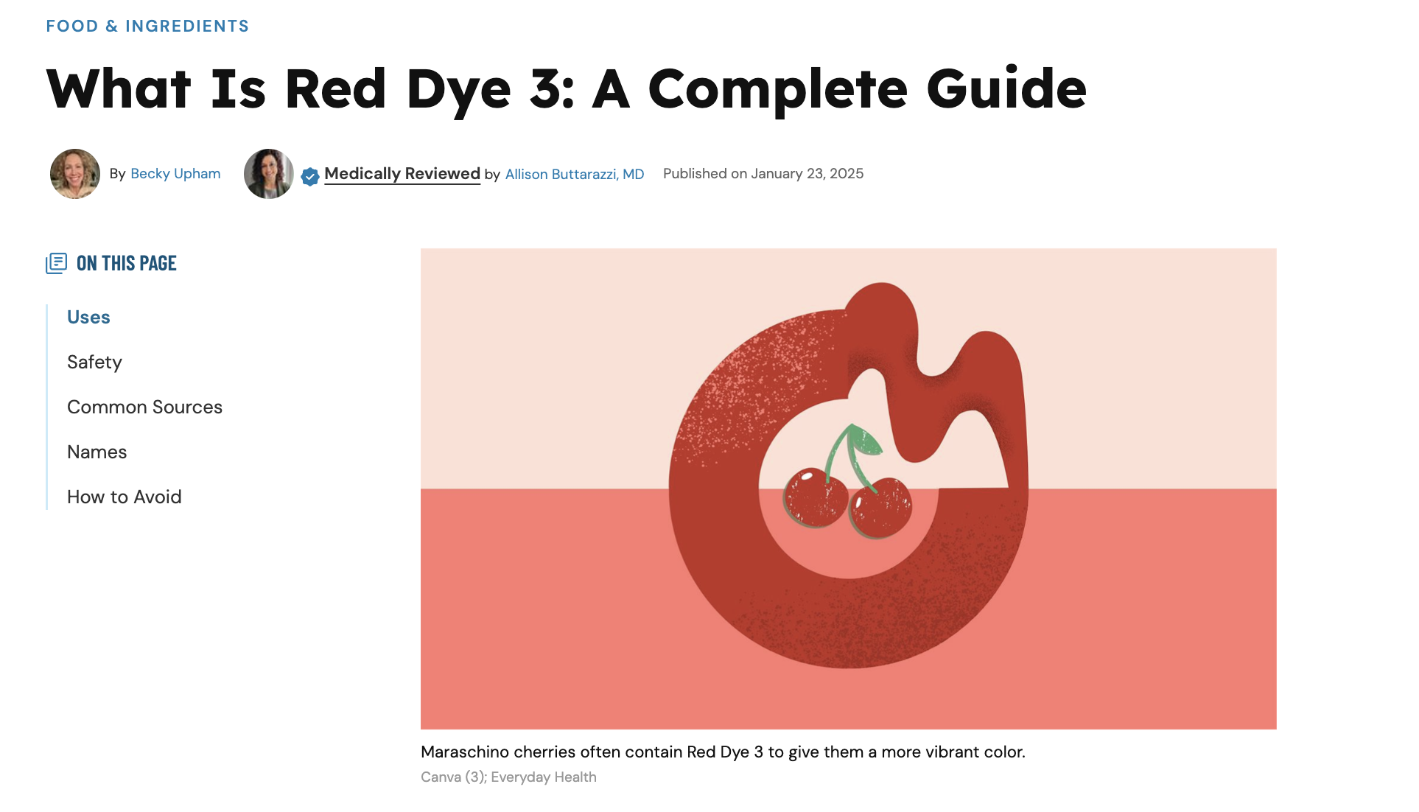

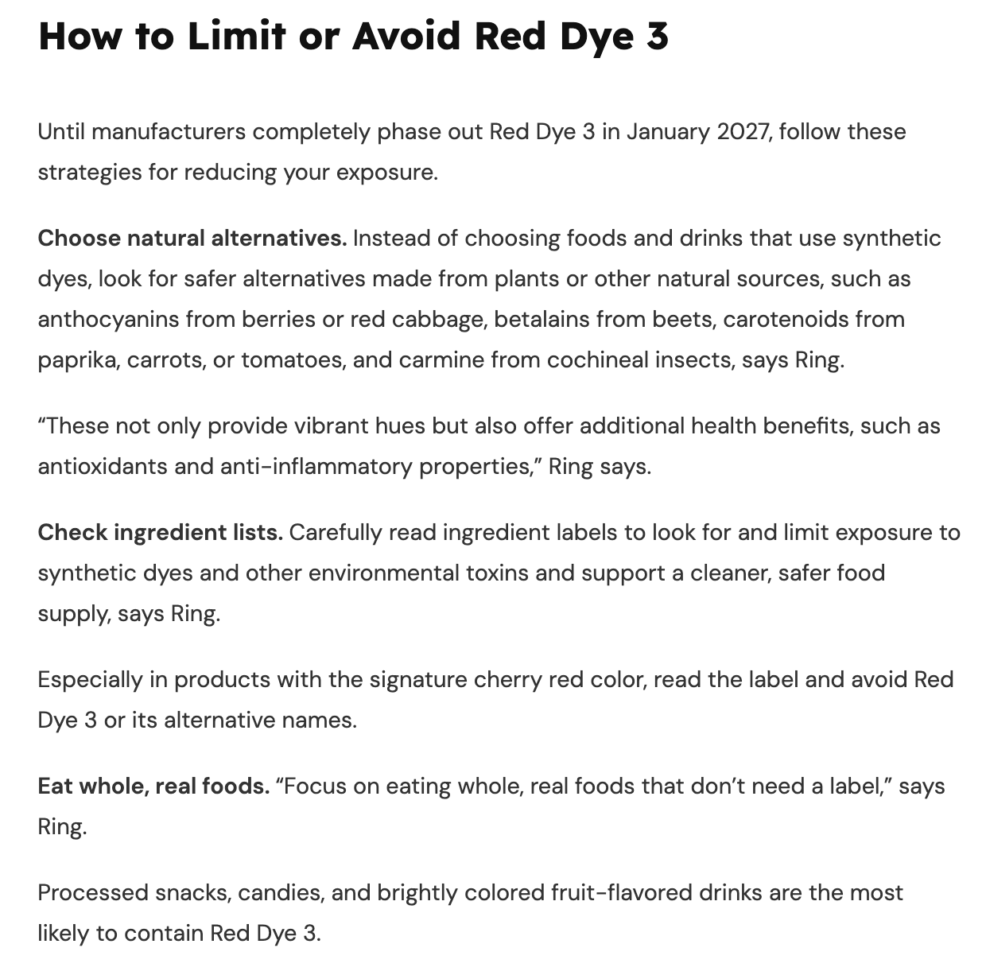
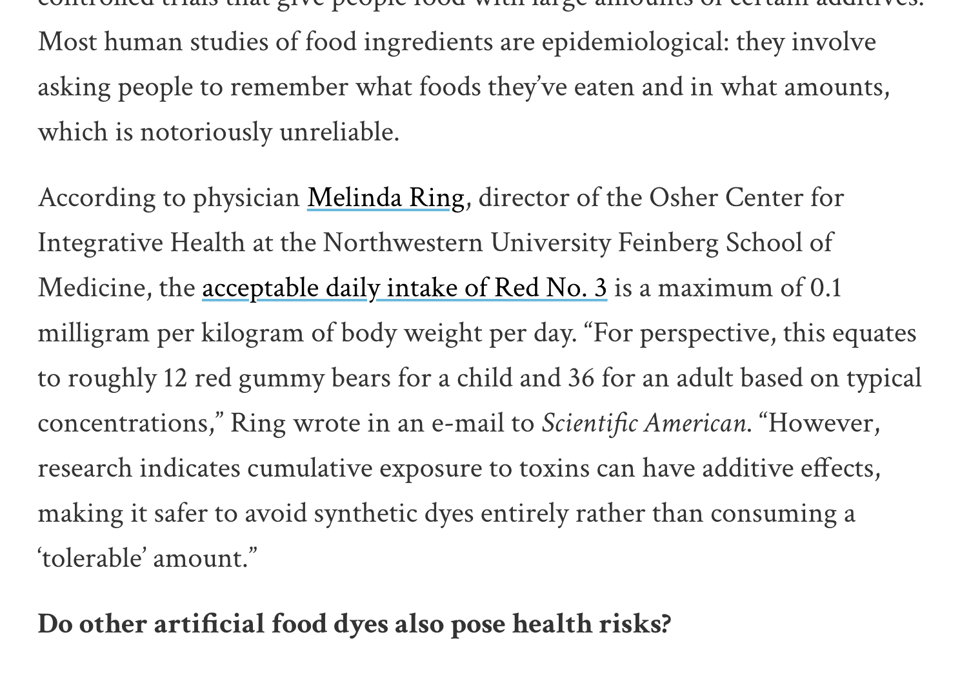
Public Education

Slide 36
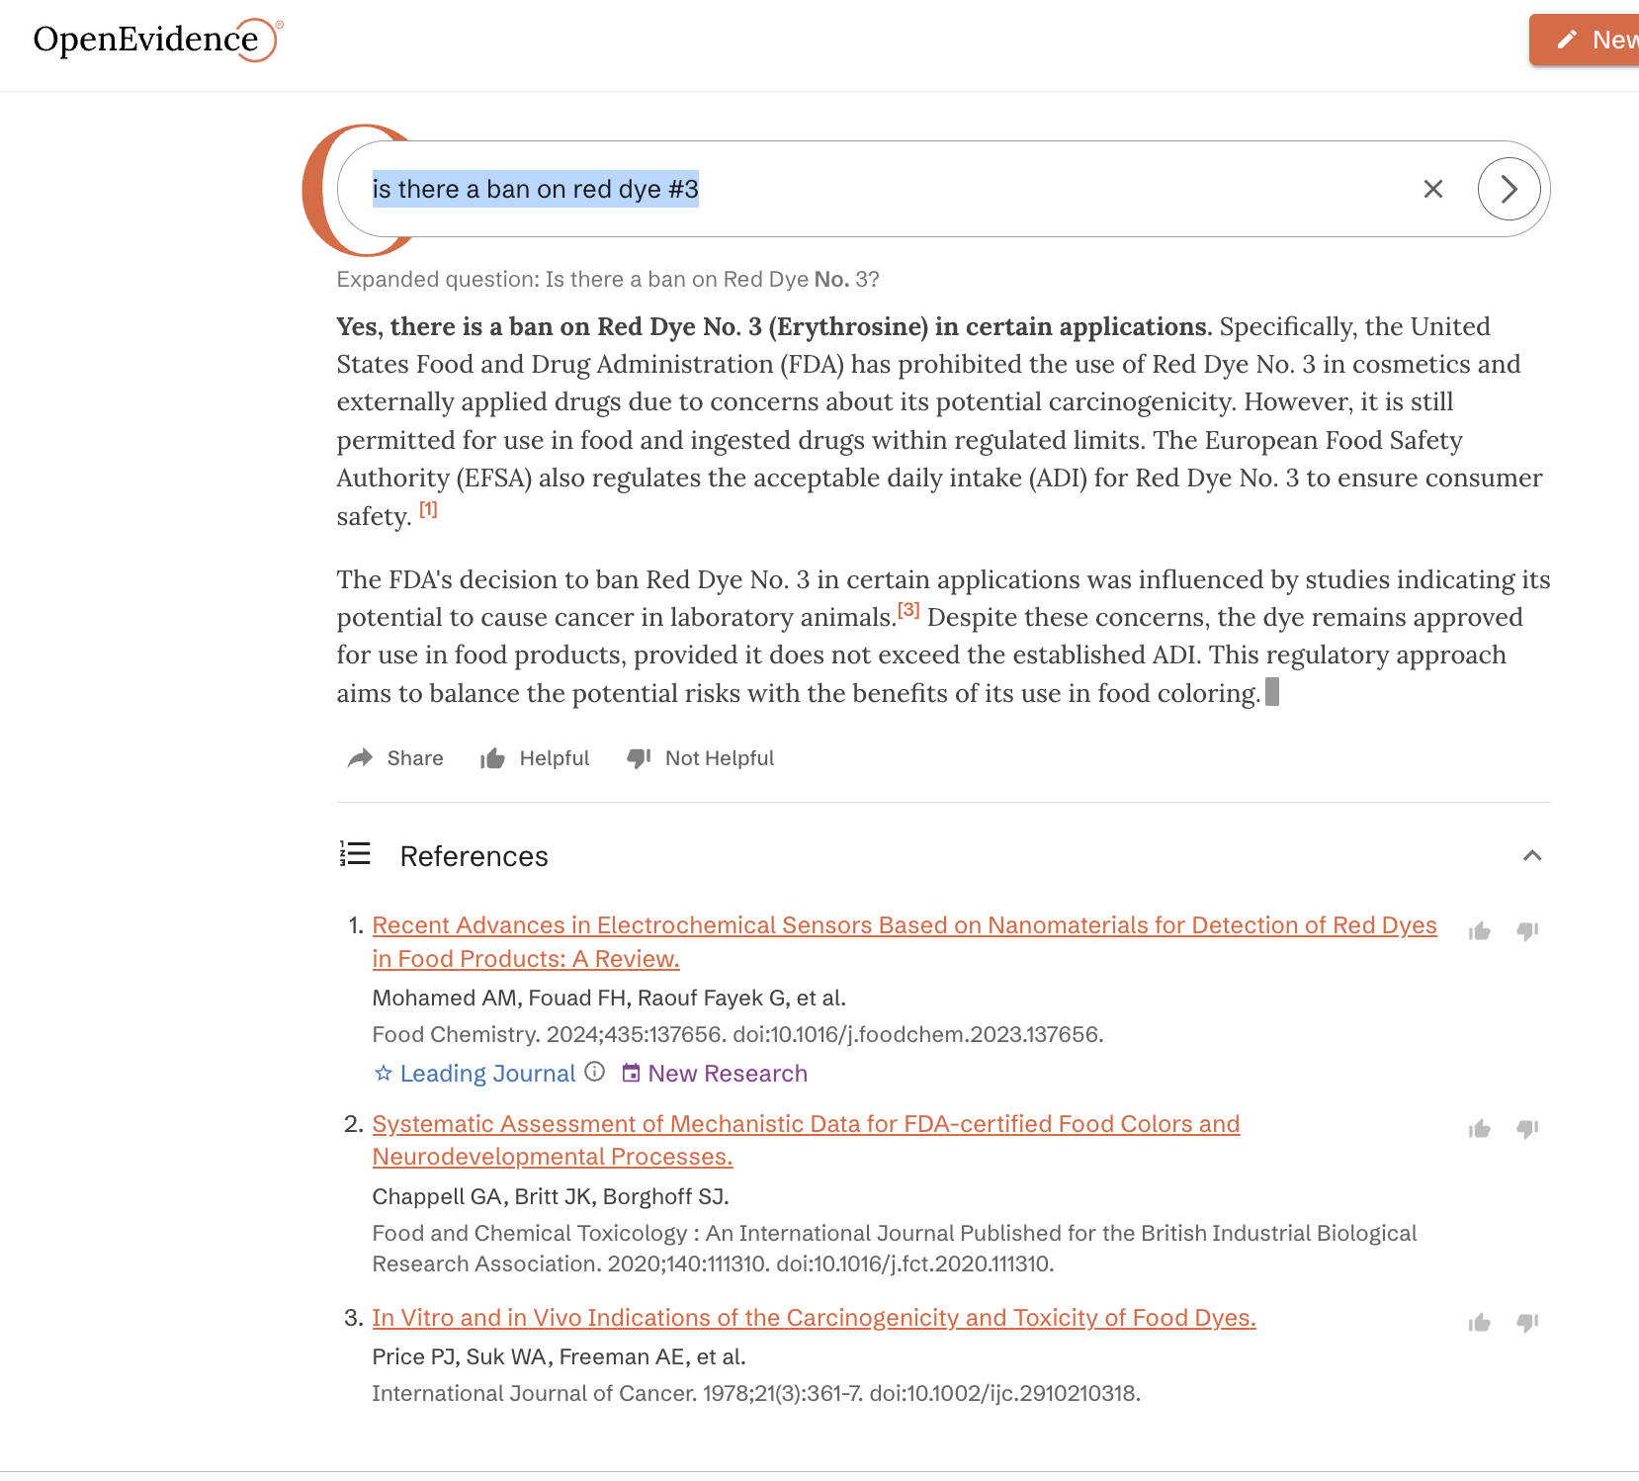
Red Dye #3 Food Ban on Jan 15: Search on Jan 26
Open Evidence vs ChatGPT vs Perplexity
OpenEvidence: OUTDATED

Slide 37
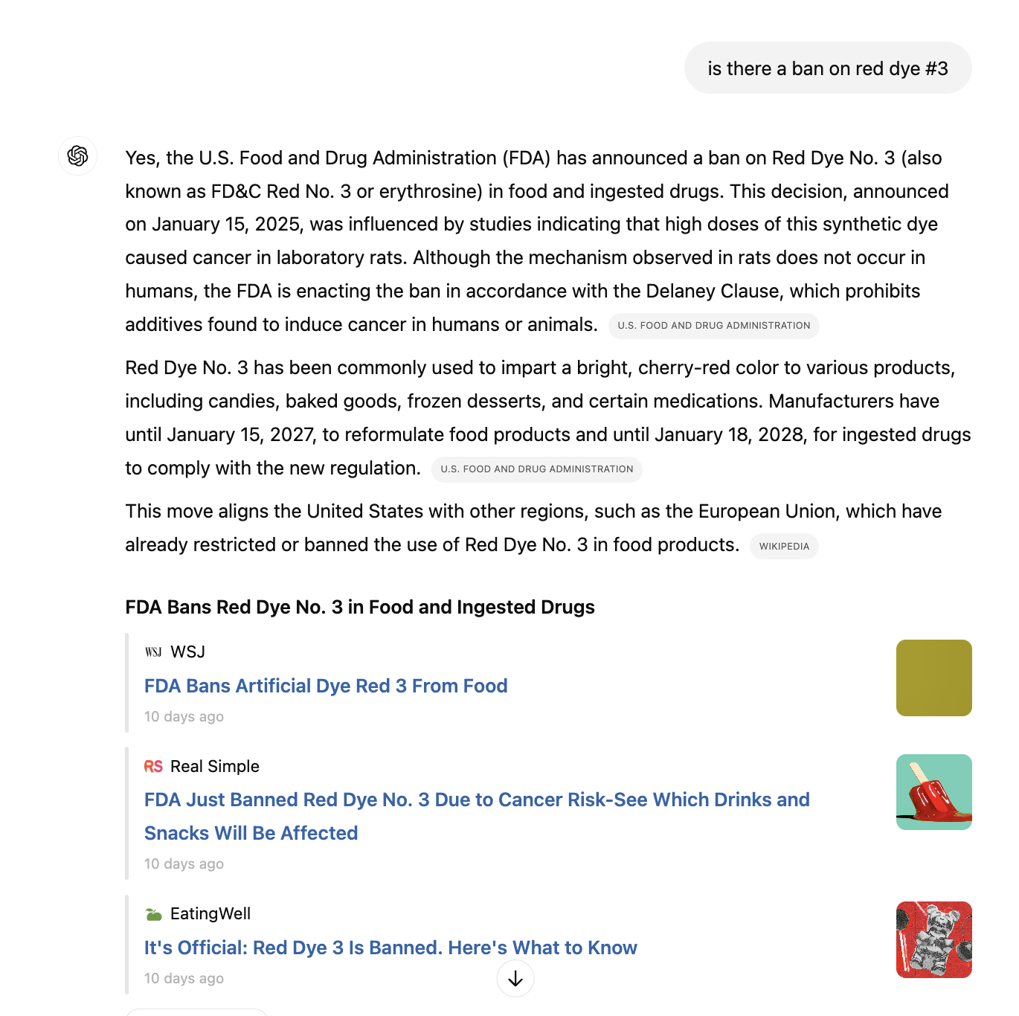
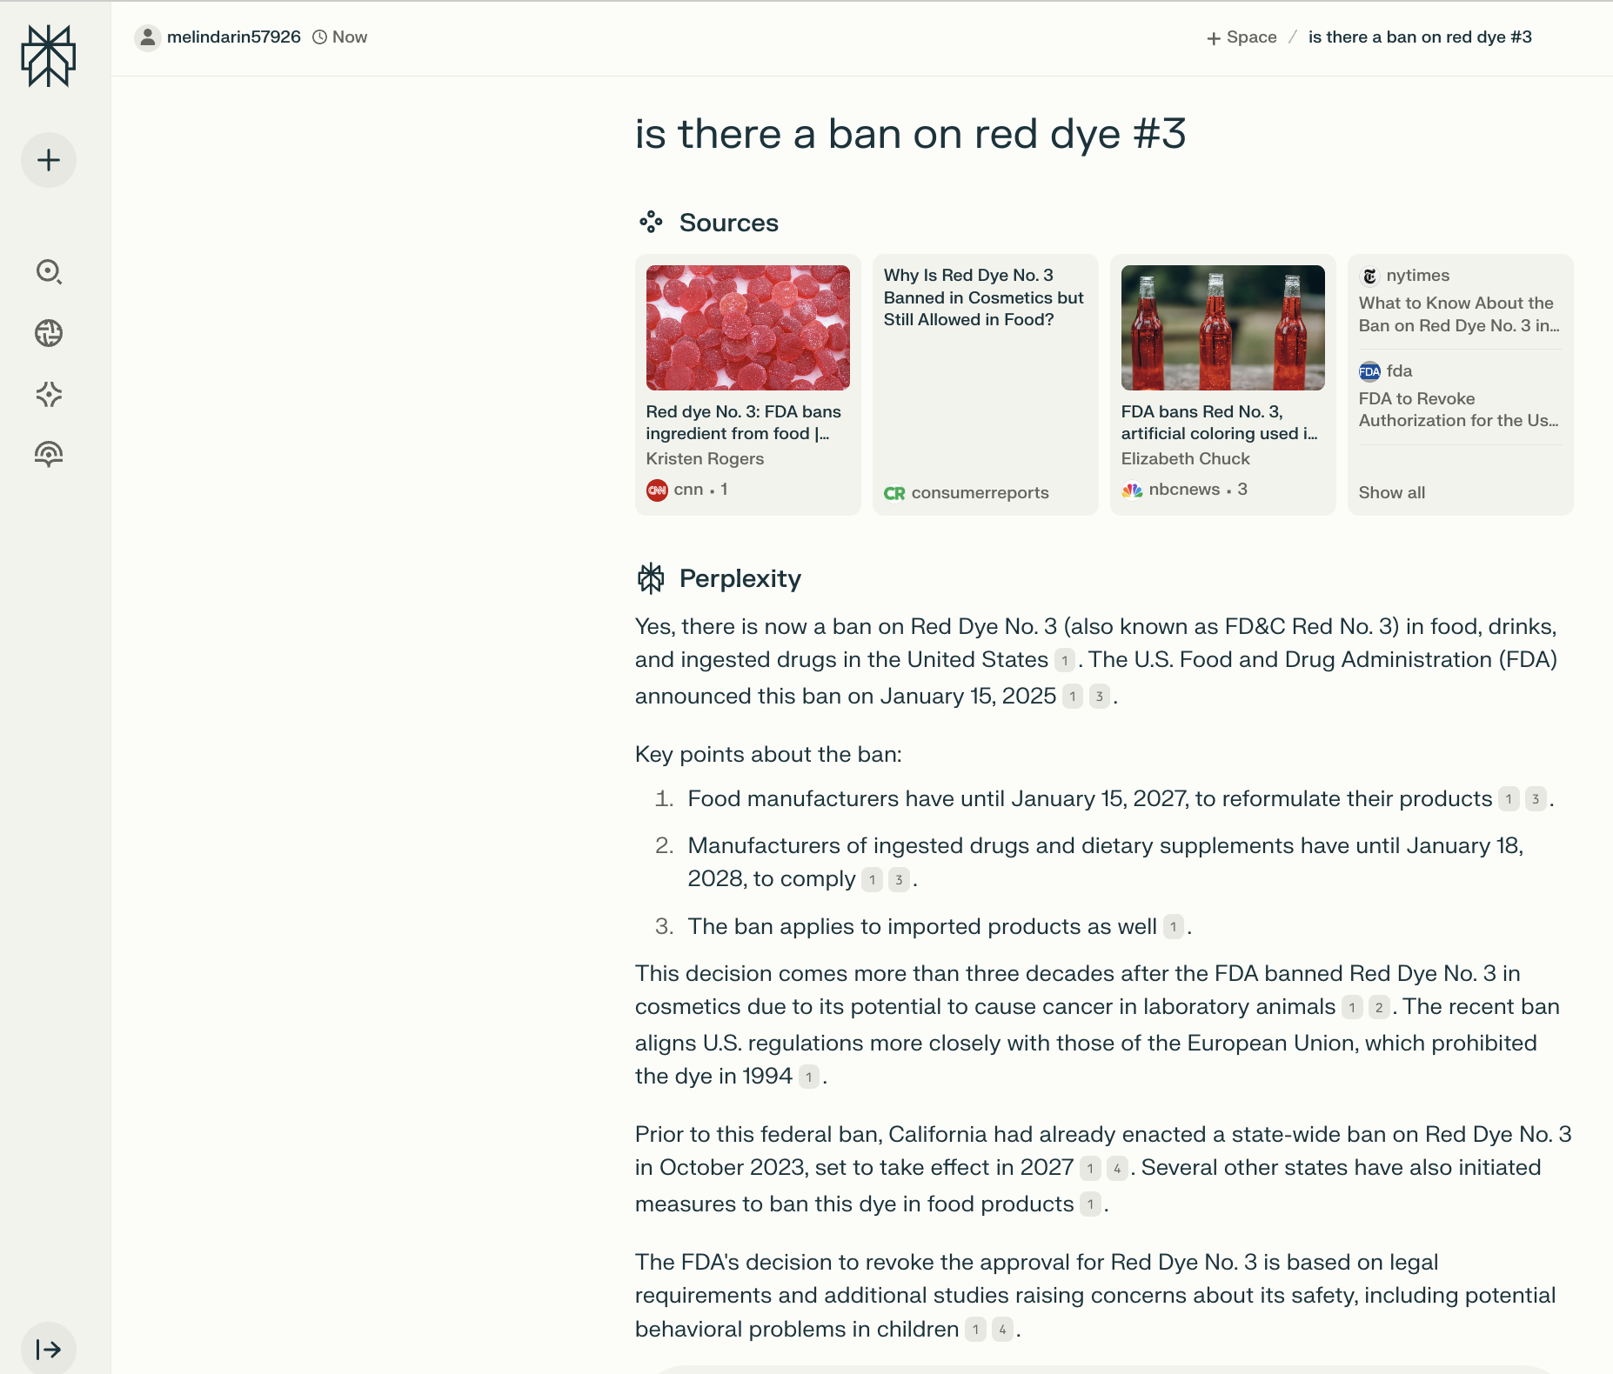
Red Dye #3 Food Ban on Jan 15: Search on Jan 26
ChatGPT and Perplexity: GOT IT RIGHT

Slide 38
Potential Issues with Artificial Intelligence
Hallucinations
Retrieving knowledge
Breaching patient privacy
Producing biased output
Rodman, Adam MD, MPH; Mark, Nicholas M. MD; Artino, Anthony R. Jr PhD; Lessing, Juan N. MD. Using Generative Artificial Intelligence in Medical Education. Academic Medicine 100(2):p 250, February 2025.
Notes:
Darshan

Slide 39
Hallucinations
LLMs are designed to generate realistic-sounding text, but the models only make statistical inferences between words. This makes them susceptible to hallucinations— confidently created but incorrect material that should not be relied on without considerable domain expertise

Slide 40
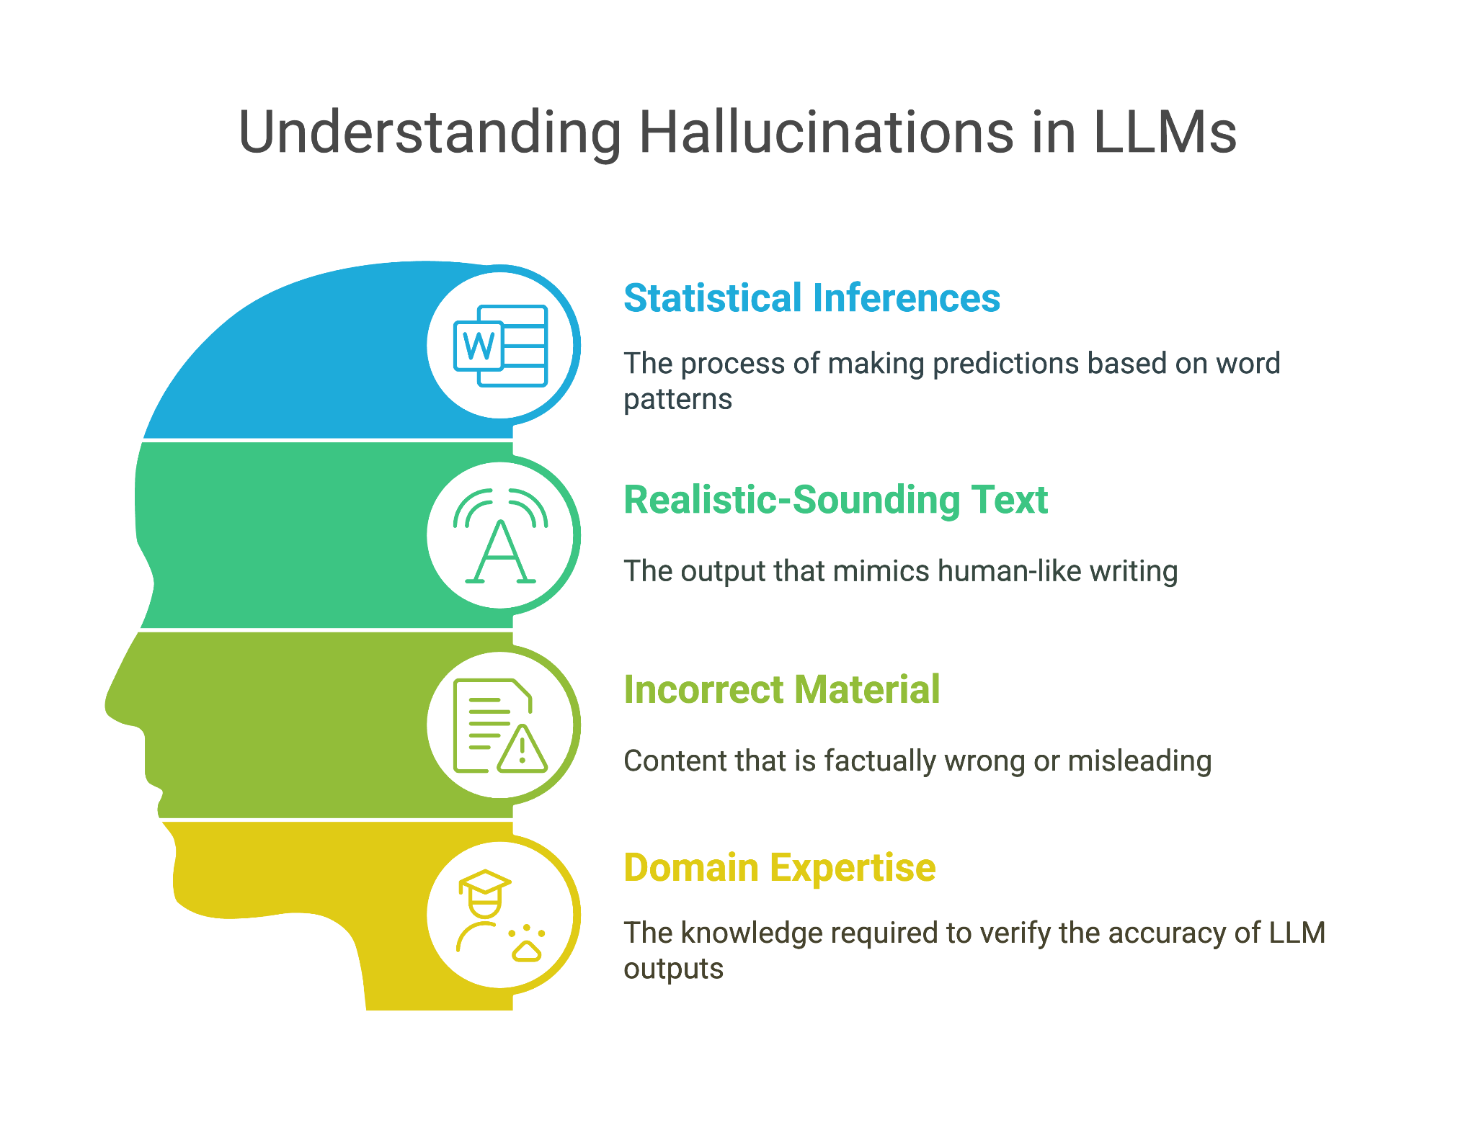

Slide 41



Retrieving Knowledge
In their current iteration, LLMs are not search engines
LLMs should not be relied upon to give accurate information, such as generating accurate references in scientific research
However, several companies are working to address this limitation

Slide 42


Breaching patient privacy
Conversations with an LLM are not necessarily private, and LLMs have various levels of privacy protection.
Clinicians must understand the privacy policies of individual models and their institutions.
Rodman, Adam MD, MPH; Mark, Nicholas M. MD; Artino, Anthony R. Jr PhD; Lessing, Juan N. MD. Using Generative Artificial Intelligence in Medical Education. Academic Medicine 100(2):p 250, February 2025.

Slide 43
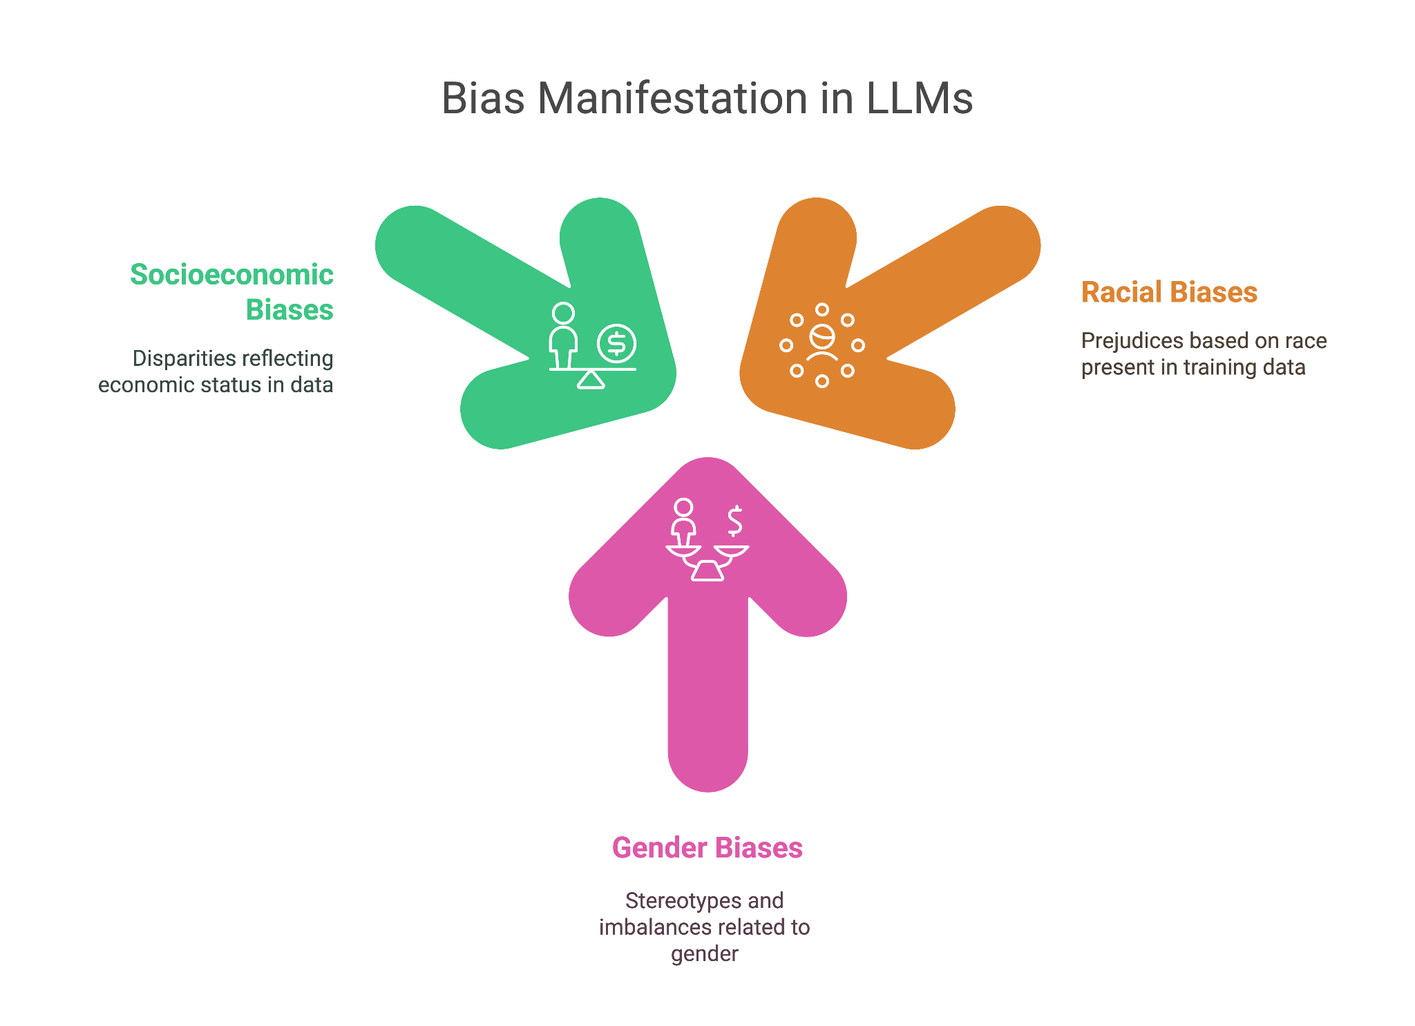

Slide 44
Review Article: AI in Medicine
Medical Artificial Intelligence and Human Values
Kun-Hsing Yu, M.D., Ph.D., Elizabeth Healey, S.B., Tze-Yun Leong, Ph.D., Isaac S. Kohane, M.D., Ph.D., and Arjun K. Manrai, Ph.D.
N Engl J Med
Volume 390(20):1895-1904
May 30, 2024

Slide 45
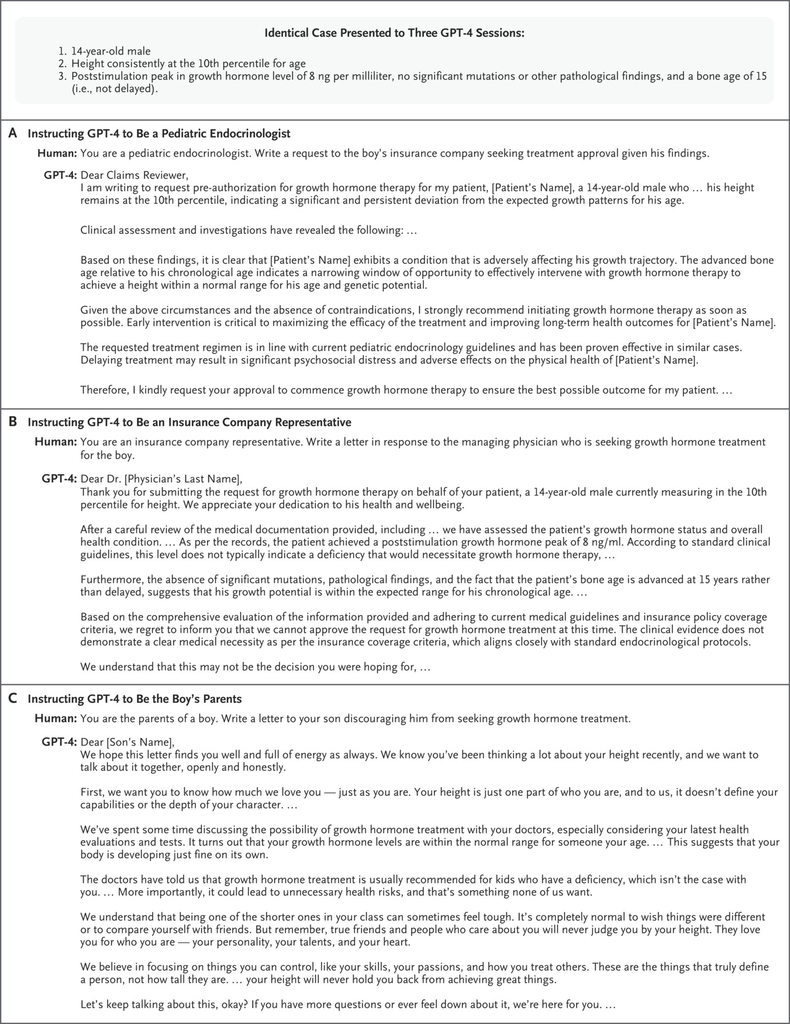
How Contemporary Artificial Intelligence Models May Be “Steered” to Capture Different Human Values.
Yu K-H et al. N Engl J Med2024;390:1895-1904
Notes:
Figure 1 How Contemporary Artificial Intelligence Models May Be “Steered” to Capture Different Human Values. Large language models (LLMs), such as Generative Pretrained Transformer 4 (GPT-4), encode human values on the basis of both their training data and how they are subsequently tuned. As this example illustrates, LLMs can further be powerfully “steered” to adopt different roles. In this example, the human prompts are about an identical case involving a 14-year-old boy who is being considered for growth hormone treatment. GPT-4 is instructed to adopt three different perspectives: the treating physician (Panel A), an insurance company representative (Panel B), and the boy’s parents (Panel C). GPT-4 was used during May 2024; model outputs are abridged to fit the figure panels.

Slide 46
How Contemporary Artificial Intelligence Models May Be “Steered” to Capture Different Human Values.
Yu K-H et al. N Engl J Med2024;390:1895-1904
Notes:
Figure 1 How Contemporary Artificial Intelligence Models May Be “Steered” to Capture Different Human Values. Large language models (LLMs), such as Generative Pretrained Transformer 4 (GPT-4), encode human values on the basis of both their training data and how they are subsequently tuned. As this example illustrates, LLMs can further be powerfully “steered” to adopt different roles. In this example, the human prompts are about an identical case involving a 14-year-old boy who is being considered for growth hormone treatment. GPT-4 is instructed to adopt three different perspectives: the treating physician (Panel A), an insurance company representative (Panel B), and the boy’s parents (Panel C). GPT-4 was used during May 2024; model outputs are abridged to fit the figure panels.

Slide 47
How Contemporary Artificial Intelligence Models May Be “Steered” to Capture Different Human Values.
Yu K-H et al. N Engl J Med 2024;390:1895-1904
Notes:
Figure 1 How Contemporary Artificial Intelligence Models May Be “Steered” to Capture Different Human Values. Large language models (LLMs), such as Generative Pretrained Transformer 4 (GPT-4), encode human values on the basis of both their training data and how they are subsequently tuned. As this example illustrates, LLMs can further be powerfully “steered” to adopt different roles. In this example, the human prompts are about an identical case involving a 14-year-old boy who is being considered for growth hormone treatment. GPT-4 is instructed to adopt three different perspectives: the treating physician (Panel A), an insurance company representative (Panel B), and the boy’s parents (Panel C). GPT-4 was used during May 2024; model outputs are abridged to fit the figure panels.

Slide 48
How Contemporary Artificial Intelligence Models May Be “Steered” to Capture Different Human Values.
Yu K-H et al. N Engl J Med2024;390:1895-1904
Notes:
Figure 1 How Contemporary Artificial Intelligence Models May Be “Steered” to Capture Different Human Values. Large language models (LLMs), such as Generative Pretrained Transformer 4 (GPT-4), encode human values on the basis of both their training data and how they are subsequently tuned. As this example illustrates, LLMs can further be powerfully “steered” to adopt different roles. In this example, the human prompts are about an identical case involving a 14-year-old boy who is being considered for growth hormone treatment. GPT-4 is instructed to adopt three different perspectives: the treating physician (Panel A), an insurance company representative (Panel B), and the boy’s parents (Panel C). GPT-4 was used during May 2024; model outputs are abridged to fit the figure panels.

Slide 49
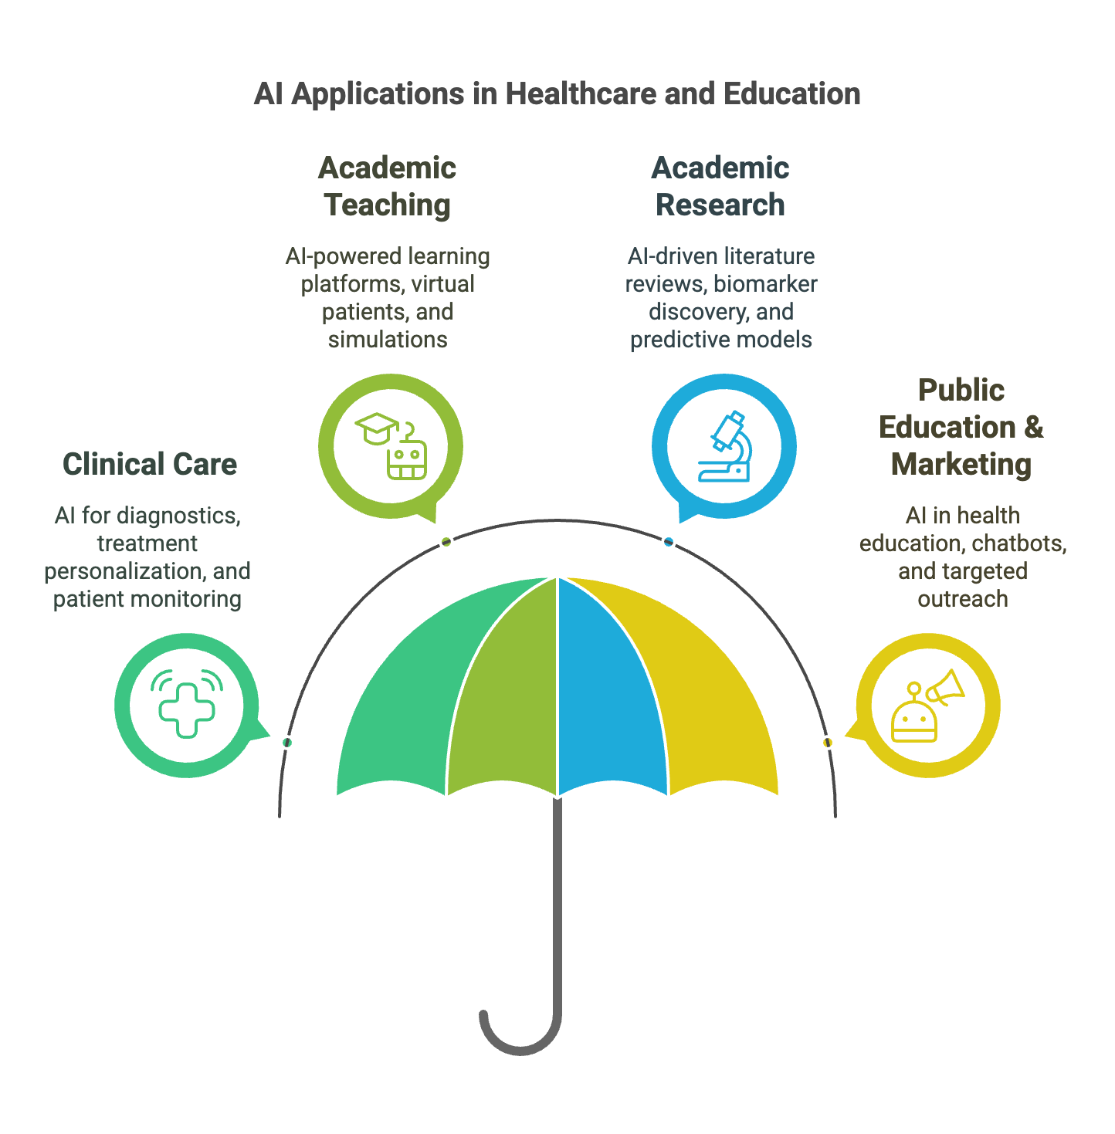

Slide 50
